Slide 1


Time to revisit prognostication in PV?
Mary Frances McMullin
m.mcmullin@qub.ac.uk
Professor of Haematology,
Queen’s University Belfast, N. Ireland

Slide 2
Disclosures
Novartis: Advisory boards and speaker bureau
BMS: advisory boards and clinical trial support
AbbVie: advisory boards and speaker bureau
Pfizer: speaker bureau
AOP: speaker bureau and clinical trial support
Incyte: speaker bureau and advisory board
CTI: advisory board
Sierra oncology: advisory board

Slide 3

Prognostication
The act of prophesying future events
Synonyms: forecast, foretell, predict or prophesy
What is the risk of events in the future?
Predicting overall , leukaemia –free and myelofibrosis-free survival

Slide 4
Factors associated with prognosis
Age
Blood counts: leucocytosis
Prior thrombosis
Karyotype
JAK2 allele burden
Prior treatments
Presence of fibrosis at time of diagnosis
Presence or absence of high molecular risk mutations (NGS)

Slide 5
Genes mutated in PV
Epigenetics modifiers : DNMT3A, TET2, ASXL1
Splicing factors: SF3B1, SRSF2, U2AF1.
Metabolic enzymes : IDH1 IDH2
Tumour suppressors: TP53

Slide 6
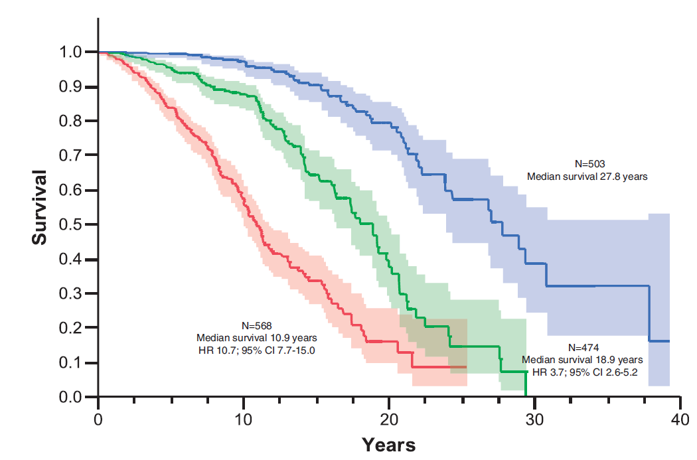
Risk-Stratified Survival in Patients With PV
Parameter | Points
Age >67 years | 5
Age 57-66 years | 2
Leucocyte count > 15 × 10⁹/l | 1
Venous thrombosis | 1
Risk | Points
Low | 0
Intermediate | 1-2
High | > 3
Tefferi A, et al. Leukemia. 2013;27(9):1874-1881, copyright 2013.

Slide 7
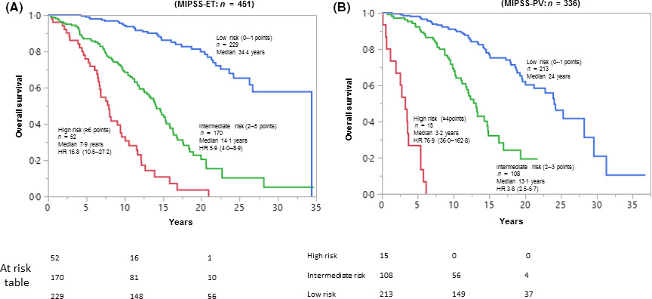
Mutation‐enhanced international prognostic systems for essential thrombocythaemia and polycythaemia vera (MIPSS-PV)
MIPSS-PV: presence of adverse mutations (SRSF2) (3 points)
Age>67yrs (2 points)
Leucocyte count >15 × 10⁹/l (1point)
Thrombosis history (1 point)
Low risk: 0-1 points
Intermediate risk: 2-3 points
High risk: >4 points
Notes:
Mutation‐enhanced international prognostic scoring system for essential thrombocythaemia (MIPSS‐ET, n = 270; A) and polycythaemia vera (MIPSS‐PV, n = 117; B), based on merged analysis of data from the Mayo Clinic and University of Florence; MIPSS‐ET was based on four risk factors: presence of adverse mutations (SRSF2, SF3B1, U2AF1 and TP53) (two points); age >60 years (four points), male sex (one point) and leukocyte count ≥11 × 109/l (one point); MIPSS‐PV was based on four risk factors: presence of adverse mutations (SRSF2) (three points); age >67 years (two points); leukocyte count ≥15 × 109/l (one point) and thrombosis history (one point).
IF THIS IMAGE HAS BEEN PROVIDED BY OR IS OWNED BY A THIRD PARTY, AS INDICATED IN THE CAPTION LINE, THEN FURTHER PERMISSION MAY BE NEEDED BEFORE ANY FURTHER USE. PLEASE CONTACT WILEY'S PERMISSIONS DEPARTMENT ON PERMISSIONS@WILEY.COM OR USE THE RIGHTSLINK SERVICE BY CLICKING ON THE 'REQUEST PERMISSIONS' LINK ACCOMPANYING THIS ARTICLE. WILEY OR AUTHOR OWNED IMAGES MAY BE USED FOR NON-COMMERCIAL PURPOSES, SUBJECT TO PROPER CITATION OF THE ARTICLE, AUTHOR, AND PUBLISHER.

Slide 8

Personalised patient prognosis
Demographic
Age at diagnosis
Gender
Clinical
Blood counts at diagnosis
Splenomegaly
Prior thrombosis
MPN classification
  Chronic phase (PV v ET)
  Myelofibrosis
Cohort
Genomic data
34 myeloid drivers
16 copy number changes
63 VARIABLES

Slide 9
Personalised patient prognosis
ET
79yr
Female
Hb 104g/l
WCC 8.4x10^9/l
Plt 2300x10^9/l
CALR
SRSF2
IDH2
18q LOH
Courtesy of J Nangalia

Slide 10
Thrombotic risk factors
Age
History of thrombosis
Treatment with phlebotomy alone
Arterial thrombosis: Venous event
Prior arterial event and hypertension Leucocytosis
Hyperlipidaemia and diabetes Major haemorrhage

Slide 11
PV: Risk groups (BSH, 2019)
Low risk
Age < 65
And
No PV associated thrombotic history
High risk
Age ≥ 65
And/OR
prior PV associated arterial or venous thrombosis

Slide 12
BSH: Management recommendation in low-risk PV
Management options for ALL PV including low-risk patients
Target haematocrit of <0.45 in all patients (GRADE 1A)
Low dose aspirin (75 – 100 mg) in all patients (GRADE 1A)
Targeted intervention to reduce cardiovascular risk factors
Consider cytoreductive therapy in low-risk patients with various features
McMullin MF, et al. Br J Haematol 2019.184,176-191

Slide 13
BSH: Management options in high-risk PV
First Line: hydroxycarbamide or interferon (preferably pegylated interferon)
Second line: In patients treated with hydroxycarbamide 1st line, interferon as second line treatment or where treated with interferon 1st line recommend hydroxycarbamide as second-line treatment
Consider pegylated interferon as second line in those patients who have had non-pegylated interferon 1st line and could not tolerate it
Ruxolitinib 2nd /3rd line in hydroxycarbamide resistant or intolerant
(GRADE 1A)
Third-line or further treatment options
Busulfan or ³²P or pipobroman in those with limited life expectancy (GRADE 1B)
Anagrelide in combination with hydroxycarbamide may be helpful in those where platelet control is
difficult (GRADE 2C)
McMullin MF, et al. Br J Haematol 2019.184,176-191.

Slide 14
Proud PV: Ropeginterferon V Hydroxyurea
PROUD-PV
CONTINUATION-PV
EOT
PROUD
Inclusion
CONTI
Naive patients
in need of
cytoreduction
Stratified
Rand. by
Age,
prev. HU,
prev. TE
N=127
Ropeginterferon
N=106
N=95
Ropeginterferon
N=88
HU pre-treated
(<3yr and not
full responders)
N=127
Hydroxyurea
N=111
N=76
BAT/Control
N=73
Eligible PV patient
population per
WHO2008 criteria
For internal use only
Month 24
Efficacy Analysis
Up to 3.6 years
Safety Analysis
Month 0
Month 12
From Gisslinger H, et al. In: Proceedings from the European Hematology Association; June 14-17, 2018; Stockholm, Sweden [abstract S132].

Slide 15
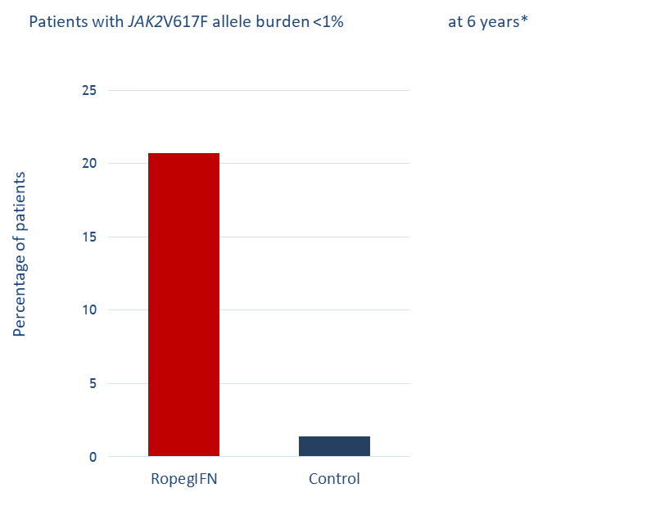
Proud PV: Event-free survival
Risk events: death, disease progression and thromboembolic events
The probability of event-free survival was significantly higher among patients treated with ropeginterferon alfa-2b compared to the control arm (maximum treatment period 7.3 years)
RopegIFN alfa-2b
Control
p=0.04 (Log-Rank)
Control
RopegIFN α-2b
Notes:
Note: y-intercept was 0 in abstract, changed to 0.5

Slide 16
MAJIC: RUXOLITINIB VERSUS BEST AVAILABLE THERAPY FOR POLYCYTHAEMIA VERA INTOLERANT OR RESISTANT TO HYDROXYCARBAMIDE IN A RANDOMISED TRIAL
MAJIC-PV is a Phase II, randomised open-label, two arm, multicentre clinical trial
ELN response
Molecular
QOL
High-risk P Vera patients intolerant or resistant to hydroxycarbamide (HC)
Best Available Therapy (BAT) *
Randomised 1:1 to
(stratified by gender)
Ruxolitinib
(if at least a PR is maintained)
Year 1
Year 2
Year 3
Year 4
Year 5
*in common with the RESPONSE trials patients could receive HC on the BAT arm
Primary outcome
Complete response per ELN (WBC ≤10, HCT ≤0.45, Plt ≤400) rate within 1 year.
Secondary outcomes
Duration of complete response
Haemorrhagic and thromboembolic event rates
Progression free and overall survival
Responses (Histological, Molecular)
Quality of life and disease symptom burden
Safety and toxicity

Slide 17
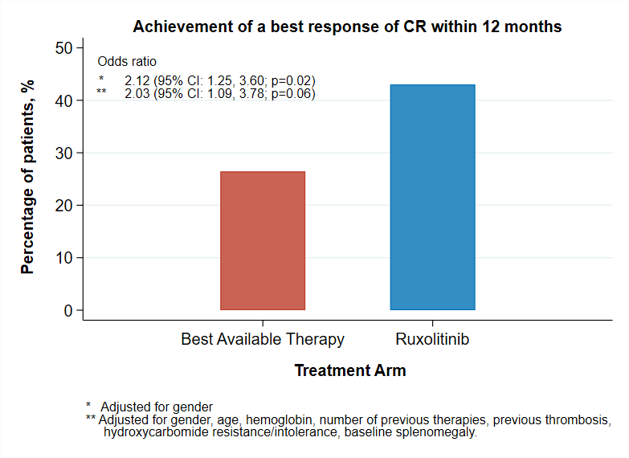
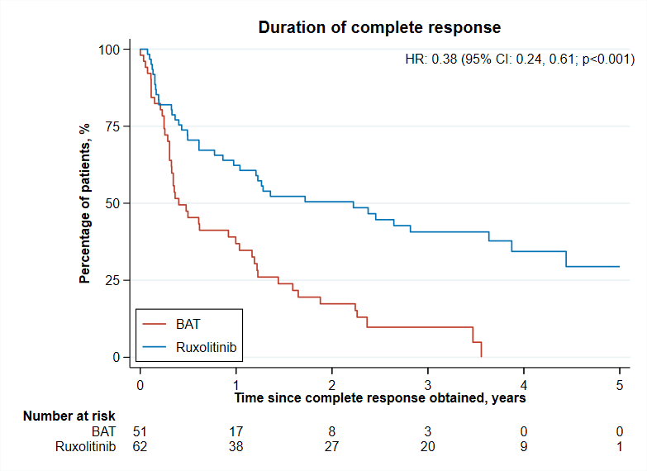
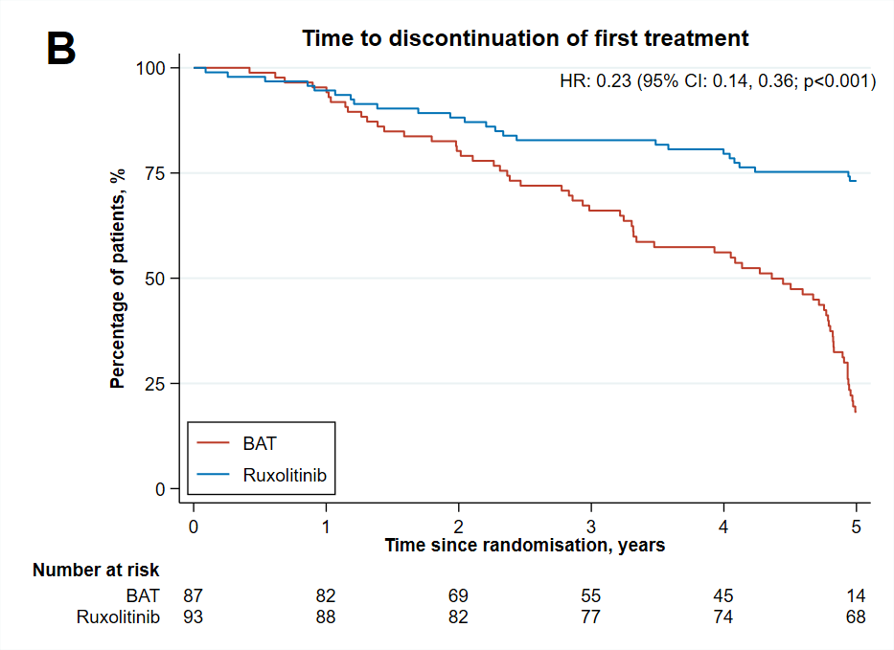
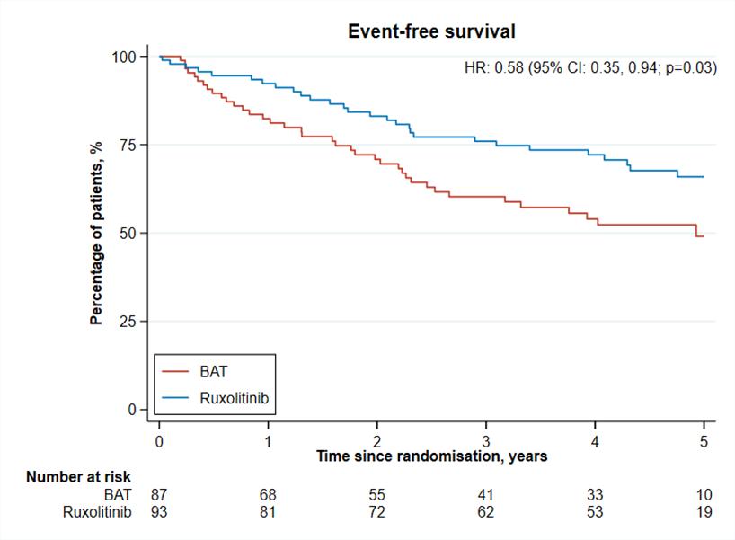
Ruxolitinib superior to BAT for CR, duration of CR, time to discontinuation and Event-Free-Survival (thrombosis, haemorrhage, transformation, death)

Slide 18
SUMMARY :MAJIC PV
MAJIC-PV confirms and challenges the current therapeutic algorithm, supporting benefits of targeted therapy and molecular monitoring in this disease.
Ruxolitinib improves thrombosis-free and event free survival in patients with high risk Polycythaemia Vera who are intolerant or resistant to hydroxycarbamide.
Complete response, regardless of treatment allocation, correlated with improved event free survival.
Embedded pre-planned analyses demonstrate that attaining a 50% reduction in JAK2 V617F VAF, was associated with important clinical benefits (improved PFS, EFS, OS) and clearance of MPN stem cells. Suggestive of disease modification.

Slide 19
Low-risk PV: is it time to change?
 | LOW RISK | HIGH RISK
Dx before 2005 IR per 100 person/yrs | IR: 2.03 % pts/yr; 95% CI: 1.58-2.61 | IR: 4.01 % pts/yr; 95% CI: 3.28-4.90
Dx after 2005 IR per 100 person/yrs | IR: 2.24 % pts/yr; 95% CI: 1.33-3.78 | IR: 2.93 % pts/yr; 95% CI: 1.89-4.54
The incidence of thrombosis in low-risk patients has remained stable over time
Low-risk patients has a two-fold increased risk of thrombosis compared to general population
Low risk
High risk
Incidence rate (% pts/year)
* Aspirin in the primary and secondary prevention of vascular disease: collaborative meta-analysis of individual partecipant data from randomized trials, Lancet 2009; 373:1849-1860.. Yusef S et al Cholesterol Lowering in Intermediate-Risk Persons without Cardiovascular Disease NEJM 2016
**The Risk and Prevention Study Collaborative Group. N−3 Fatty Acids in Patients with Multiple Cardiovascular Risk Factors. N Engl J Med 2013;368:1800-8.
§ Barbui T, et al. Practice-relevant revision of IPSET-thrombosis based on 1019 patients with WHO-defined essential thrombocythemia. Blood Cancer Journal. In press
§§ Barbui T, et al. In contemporary patients with polycythemia vera, rates of thrombosis and risk factors delineate a new clinical epidemiology. Blood 2014 124: 3021-3023

Slide 20

Low-PV phase II RCT
Study title: Benefit/Risk Profile of RopegInterferon alfa-2b in Low-risk Patients With PV (Low-PV)
ClinicalTrials.gov : NCT03003325 Italian multicenter study design
PV low-risk patients
All comers aged 18-60 without history of CV events and all inclusion/exclusion criteria satisfied
(Before entry all patients were phlebotomized to achieve HCT<45% and strictly followed-up
every month.)
Phlebotomy+ASA
Phlebotomy+ASA
+ Ropeg-IFN (100 ug fixed dose)
Primary endpoint: proportion of patients with median HCT < 45% at 1 year
Switch – Extension phase
Responder
Non-Responder
Responder
Non-Responder
Phlebotomy+ASA
Phlebotomy+ASA
+ Peg-Prol-IFN
Phlebotomy+ASA
Barbui T et al, Lancet Haematol 2021 T,

Slide 21
Primary Endpoint - 1
Definition: patients maintaining the median HCT values <45% during 12 months in the absence of progressive disease*
Odds Ratio, 3.5
(95% CI, 1.3-10.4)
p=0.0075
3 progressions of thrombocytosis associated with acroparaesthesia and erythromelalgia, confirmed after 30 days
1 splenic vein thrombosis
Barbui T et al, Lancet Haematol 2021

Slide 22
Secondary endpoint: JAK2V617F allele burden after 1year
N=37 N=29
+1.03%
-10.43%
6 (16%) of 37 patients in the experimental group had an allele burden decrease of more than 40% (up to 56%), starting from a baseline value that ranged from 72·3% to 88·0%.
Barbui et al. Lancet Haematol (2021)
Notes:
29 paz in std e 37 nell’exp avevano valori sia baseline sia a 12 mesi. la variazione media assoluta rispetto al basale era –10,43%(95% CI da –16 · 97 a –3 · 89) nel gruppo sperimentale e 1,03% (da –2 · 81 a 4 · 87) nel gruppo standard (p = 0 · 0060). Tuttavia, va notato che sei (16%) dei 37 pazienti nel gruppo sperimentale avevano un riduzione del carico allelico di oltre il 40% (fino al 56%), a partire da un valore basale compreso tra 72,3% e 88,0%.

Slide 23
ELN 2021: recommendations for cytoreductive drug therapy in low-risk PV
Recommended
Poor tolerance of phlebotomy
Symptomatic progressive splenomegaly
Persistent leucocytosis
Considered
Extreme thrombocytosis
Inadequate haematocrit control
Trial of drugs considered
Patients with high symptom control
Patients reporting a relevant CV risk
Marchetti M et al, Lancet haem 2022 e301

Slide 24
Conclusions
Treatment with interferons in low risk disease may be justified as may reduce the risk of events and the allele burden.
Agents available for high risk disease (rogpeginterferon alfa-2b, ruxolitinib) may have improved efficacy and reduce clonal burden of disease thereby altering outcomes
Therefore are the current prognostication /risk groups valid or as all patients at increased risk of events/progression is cytoreductive treatment justified in all or a greater number.

Slide 25
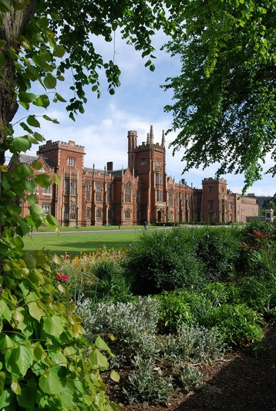
Thank you for your attention : Questions?
’

