Slide 1

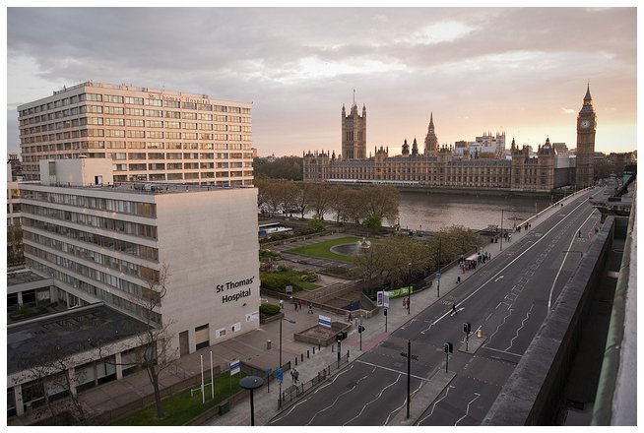

Fedratinib in 2023 and beyond……..
Claire Harrison, MD
Guy’s and St Thomas’, NHS Foundation Trust
London, UK
Claire.Harrison@gstt.nhs.uk

Slide 2
Disclosures
Research funding Novartis, BMS/Celgene, Constellation
Institutional and speaker funding Novartis, BMS/Celgene, CTI, Gilead, GSK, Shire, Roche, Jannsen, Promedior, Geron, Galacteo, AOP, Keros, Sierra.

Slide 3
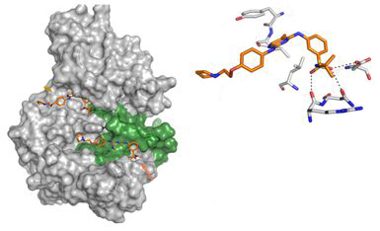
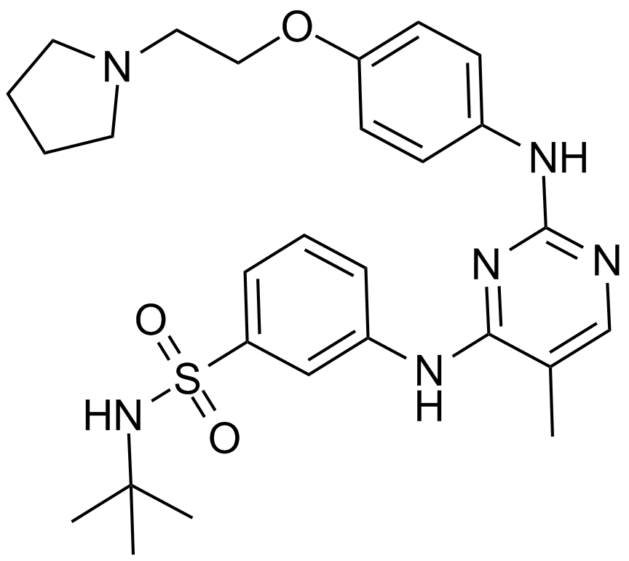
Fedratinib – a selective JAK2-Inhibitor
Fedratinib is a JAK inhibitor with
Activity against wild type and mutationally activated JAK2 and FLT3¹¹
Selective JAK2 inhibitor with higher inhibitory activity over family members JAK1, JAK3, and TYK2¹¹
Exhibits dual binding to JAK2 which may help prevent genetic resistance²
Shown to inhibit BRD4 in AML and MM cells¹²
Dual binding of ATP and substrate binding domains by fedratinib.^{1,2}
Effective half life of 41h.¹¹
ATP-site
Fedratinib
Substrate binding site
U.S. FDA approval
(August 2019)⁸
Health Canada approval
(September 2020)⁹
EMA approval
(February 2021)¹⁰
Selected clinical trials in MF with Fedratinib*
JAKARTA (Ph 3)³
JAKARTA-2 (Ph 2)^{4,5}
FREEDOM-001⁶
FREEDOM-002⁷
Fedratinib is a selective
inhibitor for JAK2 within the JAK family^{1,2}
Caution re Wernicke’s enceophaolpathy
monitoring of thiamine needed
1. Mughal TI et al. Int J Gen Med 2014;7:89-101. 2. Kesarwani M et al. Sci Rep 2015;5:14538. 3. Pardanani A et al. JAMA Oncol 2015;1(5):643-651. 4. Harrison CN et al. Lancet Haematol 2017;4(7):e317-e324. 5. Harrison CN et al. Am J Hematol 2020;95(6):594–603. 6. https://clinicaltrials.gov/ct2/show/NCT03755518 7. https://clinicaltrials.gov/ct2/show/NCT03952039
8. https://www.fda.gov/news-events/press-announcements/fda-approves-treatment-patients-rare-bone-marrow-disorder. 9. https://www.bms.com/ca/en/media/press-release-listing/2020-09-21-press-release.html. 10. https://news.bms.com/news/details/2021/Bristol-Myers-Squibb-Receives-European-Commission-Approval-for-Inrebic-fedratinib-for-Adult-Patients-with-Newly-Diagnosed-and-Previously-Treated-Myelofibrosis/default.aspx 11. Inrebic® (fedratinib) US Prescribing Information August 2019. 12. Ciceri P et al. Nat Chem Biol 2014;10:305–312
Notes:
Additional clinical trials of Fedratinib in MF: NCT00724334, NCT00631462, NCT01420770.
6. U.S. National Library of Medicine. ClinicalTrials.gov website. https://clinicaltrials.gov/ct2/show/NCT03755518 Accessed February 2, 2021.
7. U.S. National Library of Medicine. ClinicalTrials.gov website. https://clinicaltrials.gov/ct2/show/NCT03952039 Accessed February 2, 2021.
8. U.S. food and drug administration. Press Announcements website. https://www.fda.gov/news-events/press-announcements/fda-approves-treatment-patients-rare-bone-marrow-disorder. Accessed February 2, 2021.
9. Bristol Myers Squibb. News Releases website. https://www.bms.com/ca/en/media/press-release-listing/2020-09-21-press-release.html. Accessed February 2, 2021.
10. Bristol Myers Squibb. Corporate/Financial News website. https://news.bms.com/news/details/2020/Bristol-Myers-Squibb-Receives-Positive-CHMP-Opinion-for-Inrebic-fedratinib-for-Adult-Patients-with-Newly-Diagnosed-and-Previously-Treated-Myelofibrosis/default.aspx. Accessed February 2, 2021.

Slide 4
Study designs………………
JAKARTA|JAKARTA2
  In JAKARTA, pts were randomized 1:1:1 to receive FEDR 400 mg/d, FEDR 500 mg/d, or PBO for ≥6 4-week cycles (randomized Tx period)
    At the end of cycle 6 (EOC6) (or earlier in cases of progressive disease [PD]), pts randomized to PBO could cross-over to FEDR
  In JAKARTA2, all pts received FEDR 400 mg/d (starting doseª)
  Pts in both trials could continue to receive FEDR until disease progression / unacceptable toxicity (or clinical hold)
 | JAKARTA | JAKARTA2
Study phase | 3 | 2
Study design | Randomized, double-blind, PBO-controlled | Single-arm
Treatment arms | PBO FEDR 400 mg/d FEDR 500 mg/d 1:1:1 randomization | FEDR 400 mg/dª
Study population | JAK-inhibitor–naïve | Resistant or intolerant to prior RUX Tx
 | Int-2 or High risk | Int-1 (symptomatic), Int-2, or High risk
 | Platelets ≥ 50 ×10⁹/L | Platelets ≥ 50 ×10⁹/L
 | Primary, post-ET, post-PV MF | Primary, post-ET, or post-PV MF
ªDose-escalation was permitted up to FEDR 600 mg/d if a pt experienced <50% reduction in spleen size at end of cycle 2 or cycle 4.
d, day(s); EOC6, end of cycle 6; ET, essential thrombocythemia; FEDR, fedratinib; Int, intermediate; JAK, Janus kinase; MF, myelofibrosis; PBO, placebo; PD, progressive disease; pt(s), patient(s); PV, polycythemia vera; RUX, ruxolitinib; Tx, treatment.
Notes:
This shows a quick summary of JAKARTA and JAKARTA2 trial designs.
While there was a fedratinib 500 mg arm in the JAKARTA trial, the recommended fedratinib dose is 400 mg/day and these analyses are limited to the fedratinib 400 mg/day dose (and placebo in the JAKARTA trial).
Importantly, patients in the placebo arm of JAKARTA could crossover to fedratinib at the end of 6 treatment cycles or earlier if they showed disease progression.

Slide 5
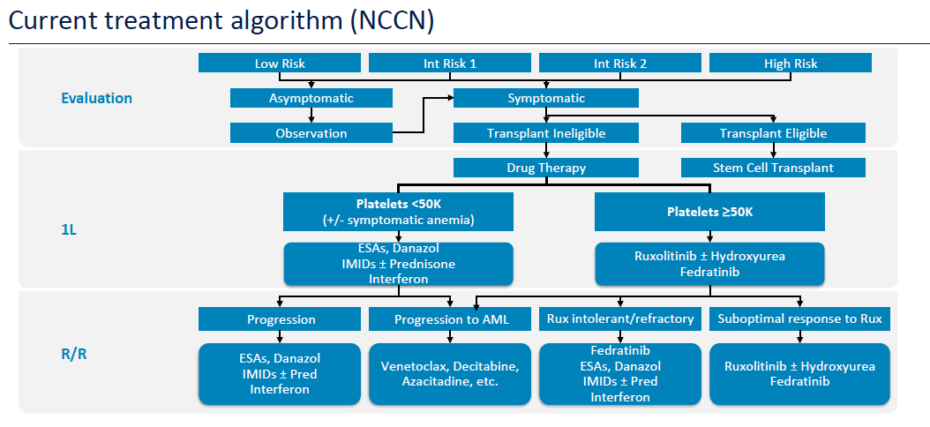
NCCN GUIDELINE FOR management of MF
NCCN guidelines 2020 – www.nccn.org
This presentation is the intellectual property of the author/presenter. Contact them at Claire.Harrison@gstt.nhs.uk for permission to reprint and/or distribute.

Slide 6
Different scenarios for JAK inhibitors in myelofibrosis
Systematic review and network meta-analysis on randomized controlled trials (7 trials; N=1953)
Texas MPN Workshop, August 26-27, 2022
In comparison with ruxolitinib
Fedratinib
1L: fedratinib associated with comparable efficacy to ruxolitinib,
less toxicity on platelets
Pacritinib
1L: less effective on splenomegaly than ruxolitinib
2L: Effective after ruxolitinib exposure
Momelotinib
1L: momelotinib associated with comparable efficacy to ruxolitinib,
less toxicity on erythrocytes
Study suggests that the choice of a JAK inhibitor may depend on the
line of treatment and the risk of onset of severe anemia and/or thrombocytopenia
1L, first line; 2L, second line.
Sureau L, et al. Blood Cancer J 2021; 7:135.
This presentation is the intellectual property of the author/presenter. Contact them at Claire.Harrison@gstt.nhs.uk for permission to reprint and/or distribute.

Slide 7
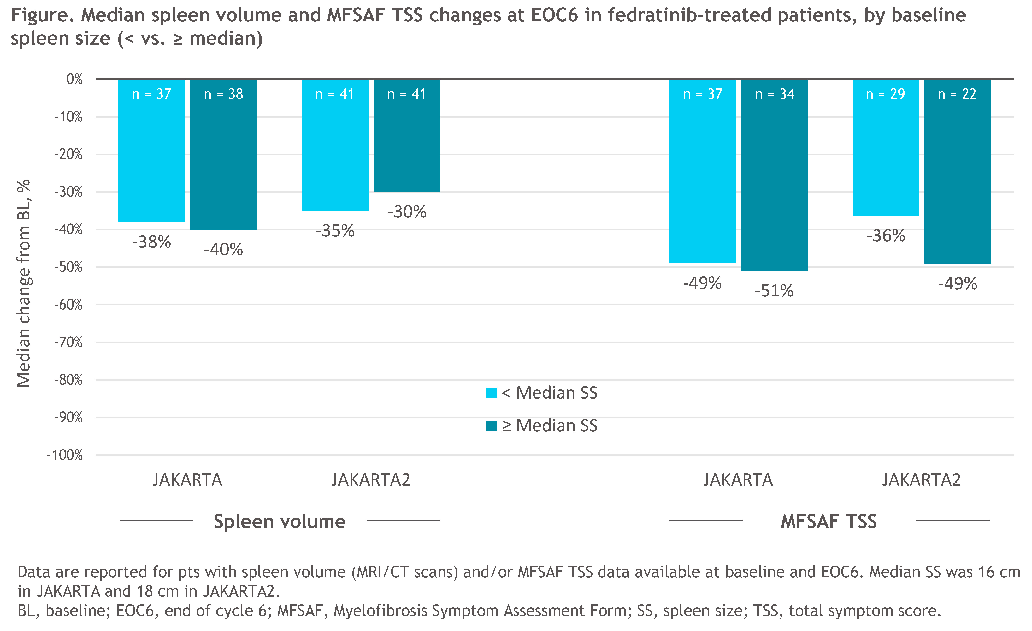
Spleen and Symptom Responses with Fedratinib (FEDR) in Patients with Myelofibrosis (MF) and Substantial Splenomegaly
Kiladjian et al ASH 2020 2576
CONCLUSION
Extent of splenomegaly at BL in JAKARTA and JAKARTA2 did not influence the likelihood of achieving improvements in spleen volume or MF symptom severity for pts receiving FEDR 400 mg/d as 1L MF Tx or as post-RUX salvage Tx.

Slide 8
SV responses for patients on fedratinib by baseline plt:
50-99 x 10⁹/L Low PLT or >100 x 10⁹/l High PLT
Spleen size responses at EOC6
Within the JAKARTA Low-PLT cohorts, the spleen size RRs at EOC6 were 43% (6/14) in the FEDR 400 mg arm, compared with 0% (0/18) in the PBO arm (P < 0.01)
  Spleen size RR in the JAKARTA FEDR 400 mg High-PLT cohort was 38% (P = 0.72 vs the FEDR 400 mg Low-PLT cohort)
Spleen size RRs with FEDR 400 mg in JAKARTA2 were also not significantly different between the Low-PLT and High-PLT cohorts: 24% and 33% (P = 0.38)
JAKARTA
P < 0.01
P = 0.72
JAKARTA2
P = 0.38
EOC6, end of cycle 6; FEDR, fedratinib; PBO, placebo; PLT, platelet; pt, patient; RR, response rate.
Harrison C BJHaem 2022 doi 10.111/bjh 18207
Notes:
May be used to answer questions such as:
What were the spleen size changes for patients with low platelets in JAKARTA and JAKARTA2?
How did the spleen size changes compare between patients with low platelets and high platelets in JAKARTA and JAKARTA2?

Slide 9
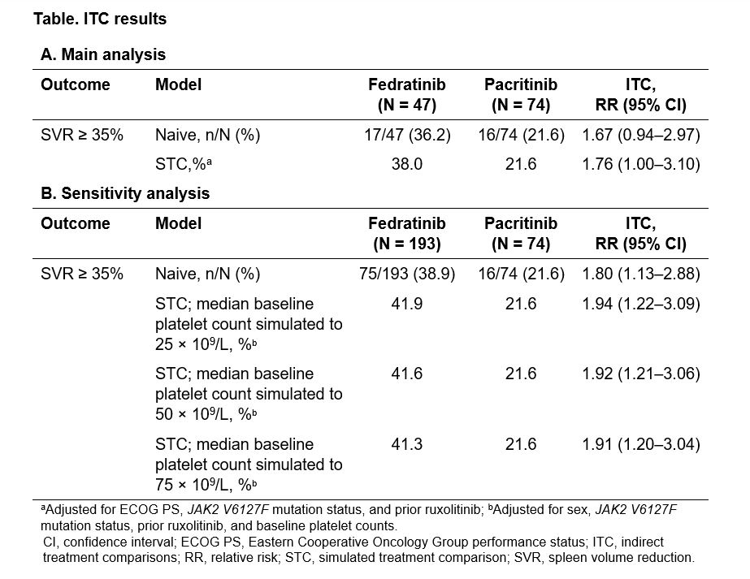
Comparative Effectiveness of Fedratinib and Pacritinib for the Treatment of Myelofibrosis in Patients with Low Platelet Counts: A Simulated Treatment Comparison Study
Daniele et al ASH 2021 5034
Effectiveness in thrombocytopenic MF: a simulated study

Slide 10
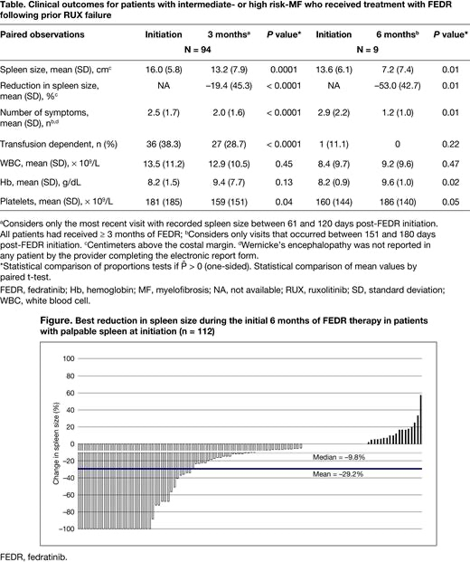
Clinical Outcomes at 3 and 6 Months of Fedratinib Therapy Following Prior Ruxolitinib Failure: Real-World Assessment of Spleen, Symptoms, and Hematologic Response Mascarenhas et al ASH 2021 1980
150 eligible patients:
Median time of follow-up post-FEDR initiation was 5 (range, 3-17) months, 55% of patients were still on FEDR.
Rationale for discontinuation of FEDR included
disease progression (43%), patient choice (19%), allogeneic stem cell transplant (18%), toxicity (6%), persistent symptoms (5%), and other (9%);
44 patients died after discontinuation.
88% had palpable spleen: mean spleen size was 16.0 (SD 5.8)cm, declined to 13.2 (SD, 7.9) cm at 3 months (P = 0.0001) and 7.2 (SD, 7.4) cm at 6 months (P = 0.01)
Mean number of symptoms declined significantly, and mean platelet count increased significantly at 3 and 6 months (Table). Best p% change in spleen size was −29.2% (median, −9.8%) Complete resolution of splenomegaly in 21% of patients.
RWE of benefit

Slide 11

Overall and progression-free survival in patients treated with fedratinib as first-line myelofibrosis therapy and after prior ruxolitinib: results from the JAKARTA and JAKARTA2 trials
JAKARTA|JAKARTA2
Claire Harrison,¹ Jean-Jacques Kiladjian,² Srdan Verstovsek,³ Alessandro Vannucchi,⁴ Ruben Mesa,⁵ Andreas Reiter,⁶ Jun Zhang,⁷ Shelonitda Rose,⁷ and John Mascarenhas⁸
¹Guy's and St Thomas' Hospital, London, United Kingdom; ²Hôpital Saint-Louis and Université de Paris, Paris, France; ³The University of Texas MD Anderson Cancer Center, Houston, United States; ⁴AOU Careggi, University of Florence, Florence, Italy; ⁵Mays Cancer Center at UT Health San Antonio MD Anderson, San Antonio, United States; ⁶Universitätsklinikum Mannheim, Mannheim, Germany; ⁷Bristol Myers Squibb, Princeton, United States; ⁸Icahn School of Medicine at Mount Sinai, New York, United States
Presentation S203……………… EHA 2020

Slide 12
Real-World Outcomes with Fedratinib Therapy in Patients Who Discontinued Ruxolitinib for Primary Myelofibrosis
Passamonti, et al ASH 2021 3645
RWA suggesting potential survival benefit… some limitations
229 MF patients were evaluated (FEDR group: n=70; non-FEDRgroup: n=159)
Median(range) duration of FEDR therapy in the FEDR group was 3.7 (0-12.2) months; 47.1% (33/70) received FEDR 400 mg; 21.4% (15/70) initiated with 200 mg FEDR once daily.
Median OS was not reached in the FEDR group and was 17 months in the non-FEDR group.
Landmark survival in the FEDR and non-FEDR groups was 91.3% and 76.5% at 3 months, and 71.6% and 53.5% at 12 months, respectively.
The Cox proportional hazards model suggested that being male, 'other' (non-white, non-black/African-American, non-Asian, non-missing) race, Charlson comorbidity index ≥1, ECOG score 2-4, and bodymass index <18.5 kg/m were significantly associated with poorer survival.
Conclusions: This RWA demonstrates that these two groups of patients with primary MF who had received prior RUX had broadly comparable baseline characteristics. FEDR appeared to be associated with improved survival up to 1 year after index compared with non-FEDR therapy.

Slide 13
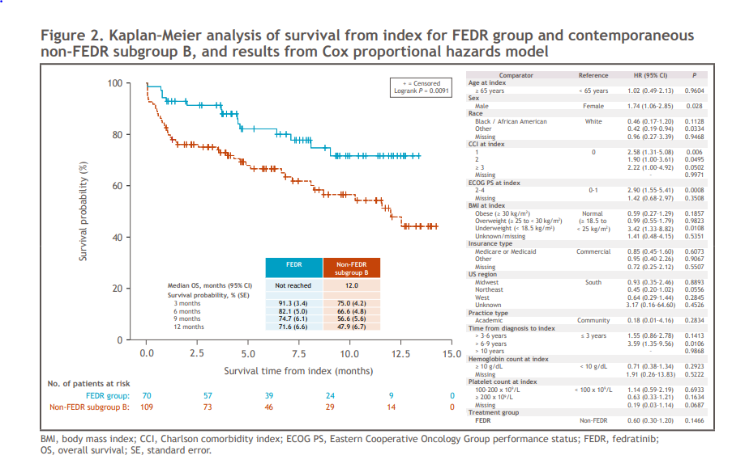
Passamonti, et al ASH 2021 Poster 3645

Slide 14
What was new at ASH?
Primary results from FREEDOM
More real world analysis
Understanding how best to fit fedratinib into our current treatment algorithm.

Slide 16
Thiamine decreases did occur but were uncommon and easily managed with routine monitoring and oral supplementation as needed.

Slide 18
Practical aspects of starting/switching therapy
Pre treatment considerations
Robustly document spleen & symptoms
Exclude infection (HIV, Hep B etc)
Assess nutrition and thiamine levels
Starting treatment
Warn patient re hematological/GI toxicity & withdrawal
If 2nd line consider direct switch or taper then switch
Monitoring on treatment
Assess spleen and symptoms
Proactively manage hematological & GI toxicity nutrition, monitor thiamine as well as strongly consider routine supplements
Assess on-going benefit
Balance spleen & symptom benefit vs toxicity
Assess for disease progression
Consider benefit of additional or next line of therapy
McLornan & Harrison Blood Advances 2020

Slide 19
Thank you

