Slide 1


Pacritinib for MF Patients with Low Platelets
MD Education: MPN Clinical Roadmap
Ruben A. Mesa, MD, FACP
President, Enterprise Cancer Service Line Atrium Health
Executive Director Atrium Health Wake Forest Baptist Comprehensive Cancer Center
Enterprise Senior Vice President Atrium Health
Vice Dean for Cancer Programs – Wake Forest School of Medicine
Professor of Medicine
Ruben.Mesa@Atriumhealth.org

Slide 2
Disclosures – Ruben Mesa, MD
Consultant (Honoraria) over past 3 years
  Novartis
  Sierra Oncology
  Genentech
  Sierra
  Blueprint
  Geron
  Telios
  CTI
  Incyte
  BMS
  Abbvie
  GSK
Research Support
  Incyte
  Sierra
  CTI
  BMS
  Abbvie
  Genentech
  Blueprint
  Morphosys

Slide 3
Quick 10
Ten things for MF patients to know about the approval of Pacritinib
How does MF impact afflicted patients?

Slide 4

Assessing MPN Burden
WHO Diagnosis Does Not Tell Whole Story
Vascular Events
PV/ET > MF
Counts matter
Can be unrecognized
Cytopenias
MF > ET/PV
Anemia
  MF 75%
  TX Dep 25%
TPN 30%
Baseline Health
Age/Medicines
Comorbidities
Progression
PV/ET to MF
PV/ET to AML
MF to AML
? 2nd MDS
Splenomegaly
MF > ET/PV
Pain not always a function of size
MPN Symptoms
MF > PV > ET
Multifactorial
Some ET/PV > MF
Cytoreductive Rx frequently not effective

Slide 5
Quick 10
Ten things for MF patients to know about the approval of Pacritinib
How does MF impact afflicted patients?
How do we treat MF currently?

Slide 6
Management of Myelofibrosis 2023
Stem Cell Transplant Soon
“Salvage” Transplant
Diagnosis of
Myelofibrosis
(Primary/ Post ET/ Post PV)
Assess Survival & Disease Burden
Develop Treatment Plan
First-line MF Medical
Management
Second-line
MF Medical Management
AP/ Blast Phase
Management
AP, accelerated phase; ET, essential thrombocytopenia; MF, myelofibrosis; PV, polycythemia vera.
Courtesy of Ruben A. Mesa, MD, FACP.

Slide 7
JAK Inhibitor Landscape 2023
Approved
Seeking Approval
Inactive
Ruxolitinib
1L – MF, 2L PV
Momelotinib
MF
Sierra Oncology
NCT04173494
XL-019
Fedratinib
MF-1L
Ruxolitinib Combinations
BMS-911543
NS - 018
MF
AZD-1480
Pacritinib
MF (Low PLT)
LY-2784544
NOW Approved

Slide 8
Ruxolitinib FDA Approved (MF)
November 16,2011

Slide 9
COMFORT-I Study Design
Randomized, double-blind, placebo-controlled, multicenter, phase 3 trial
RUX twice daily
15 mg twice daily for a PLT count of 100 × 10⁹ to 200 × 10⁹/L
20 mg twice daily for a count > 200 × 10⁹ L
n = 155
Patients (≥ 18 y) with int-2 or high-risk MF
PMF, PPV-MF, or PET-MF
PLT count ≥ 100,000
Palpable spleen ≥ 5 cm
PB < 10%
ECOG PS ≤ 3
Refractory or intolerant to or not candidates for available therapy
N = 309
R
1:1
Placebo
n = 154
Crossover for splenomegaly
n = 36
Primary endpoint: Number of patients in whom ≥ 35% SVR was achieved from BL to week 24 as measured by MRI (or CT scan in applicable patients)
Secondary endpoints: Proportion of patients with ≥ 50% reduction in TSS from BL to week 24 as measured by the MF-SAF 2.0, OS, duration of SVR
Verstovsek S, et al. N Engl J Med. 2012;366:799-807.
Notes:
Verstovsek S, Mesa R, Gotlib J, et al. A double-blind, placebo-controlled trial of ruxolitinib for myelofibrosis. N Engl J Med. 2012;366:799-807.

Slide 10
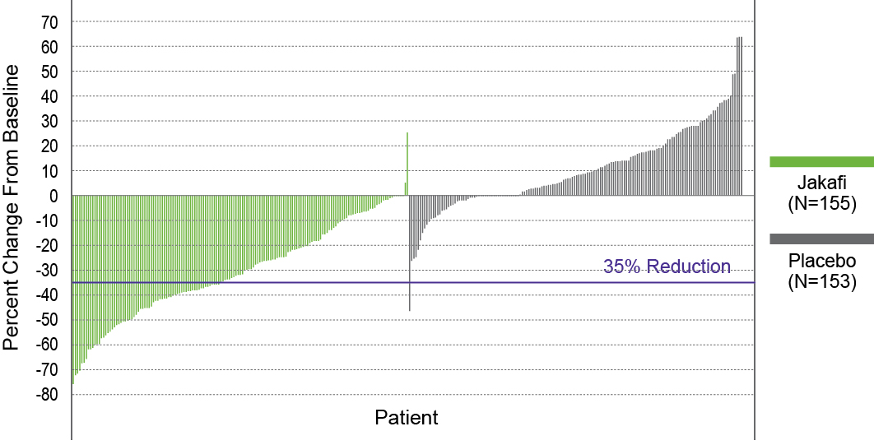
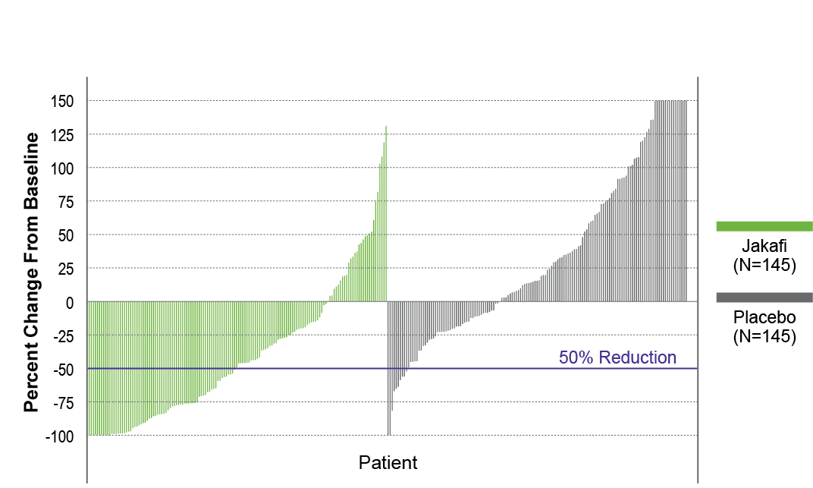
COMFORT-I
Results
Primary endpoint: the proportion of patients in whom ≥ 35% SVR was achieved from BL to week 24 (as measured by MRI or CT scan)
  41.9% in RUX group reached the primary endpoint vs 0.7% in the placebo group (P < .0001)
  A similar proportion of patients in the RUX group had a ≥ 50% reduction in palpable spleen length
SVR responses were seen with RUX in JAK2 V617F-positive patients and JAK2 V617F-negative patients, relative to placebo
SVR at 24 Weeks
TSS at 24 Weeks
RUX
(n = 155)
Placebo
(n = 153)
RUX
(n = 145)
Placebo
(n = 145)
OR, 134.4 (95% CI: 18, 1004.9); P < .0001
OR, 15.3 (95% CI: 6.9, 33.7); P < .0001
OR, odds ratio.
Verstovsek S, et al. N Engl J Med. 2012;366:799-807.
Notes:
Verstovsek S, et al. A double-blind, placebo-controlled trial of ruxolitinib for myelofibrosis. N Engl J Med. 2012;366:799-807.

Slide 11
JAKARTA-1 Study
Phase 3, randomized, double-blind, placebo-controlled trial
PMF, PPV-MF, or PET-MF
Int-2 or high risk
(IPSS)
Palpable spleen > 5 cm
PLT count > 100,000
ECOG PS ≤ 2
N = 289
Fedratinib 500 mg daily
n = 97
Fedratinib 400 mg daily
n = 96
Crossover at 6 weeks
R 1:1
Placebo
n = 96
Primary endpoint: Number of patients with ≥ 35% SVR from BL to week 24 as measured by MRI (or CT scan in applicable patients)
Key secondary endpoint: Proportion of patients with ≥ 50% reduction in TSS from BL to week 24 as measured by the MF-SAF 2.0
Pardanani A, et al. JAMA Oncol. 2015;1:643-651.
Notes:
Pardanani A, et al. Safety and efficacy of fedratinib in patients with primary or secondary myelofibrosis. A randomized clinical trial. JAMA Oncol. 2015;1:643-651.
CAR: Include ≥18 years of age in inclusion cirteria?
CAR: Could not verify 'crossover at 6 wk' - paper states crossover was permitted after 24 weeks (Study Design section, p2)

Slide 12
Fedratinib FDA Approved (MF)
August 16,2019

Slide 13
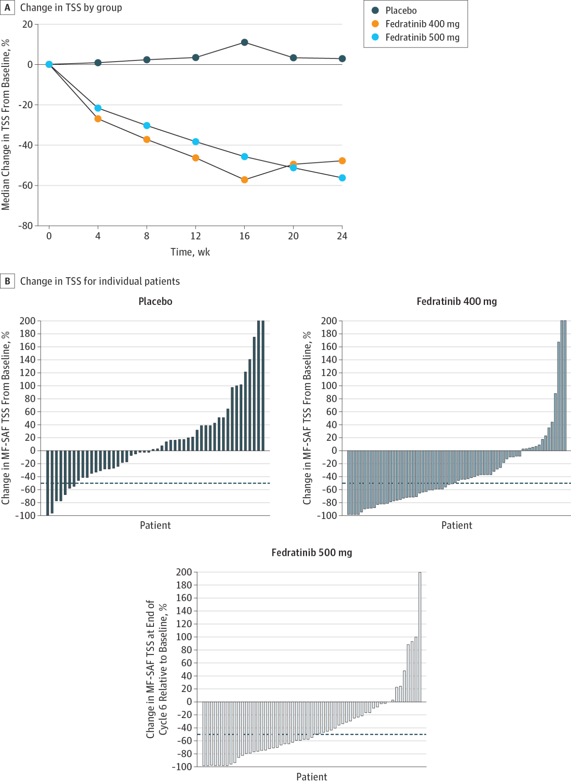
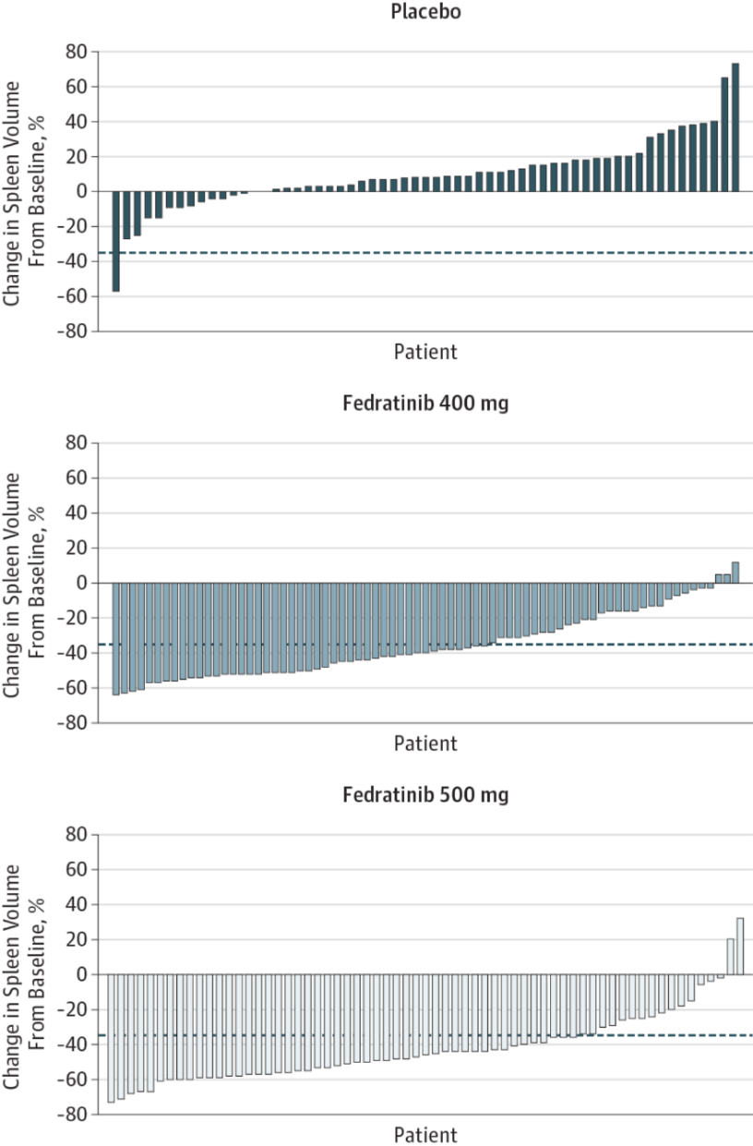
JAKARTA-1
Endpoints
N = 96
N = 85
1%
7%
n = 91
n = 96
36%, P < .001
36%, P < .001
n = 91
n = 97
40%, P < .001
34%, P < .001
Pardanani A, et al. JAMA Oncol. 2015;1:643-651.
Notes:
CAR: The n values are confusing here – some of the subgroups are higher than the main N at the top, is this correct? Also suggest adding figure titles so it is clear what each figure is representing

Slide 14
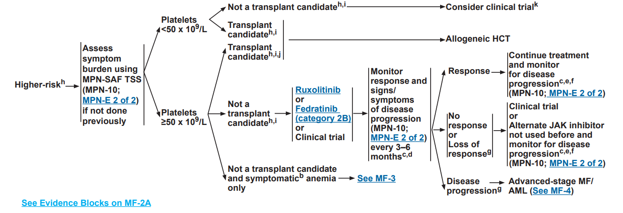
NCCN Guidelines Version 1.2021: Treatment for Higher-Risk MF
NCCN Guidelines Version 1.2021: Treatment for Higher-Risk MF
NCCN Guidelines. Myeloproliferative neoplasms. V1.2021. Accessed July 30, 2021
Notes:
NCCN Guidelines. Myeloproliferative neoplasms. Version 1.2021. 2021. Accessed August 18, 2021. https://www.nccn.org/guidelines/guidelines-detail?category=1&id=1477

Slide 15
Quick 10
Ten things for MF patients to know about the approval of Pacritinib
How does MF impact afflicted patients?
How do we treat MF currently?
What are unmet needs in current treatment of MF?

Slide 16
Primary Myelofibrosis and Secondary Myelofibrosis are Clinically and Biologically Different
The Phenotypic Spectrum of Myelofibrosis
Proliferative Myelofibrosis
Cytopenic Myelofibrosis
Normal or elevated blood counts
Lab Values (Clinical Presentation)
Lower blood counts, increased circulating blasts
More often secondary, but can progress to cytopenic
Etiology of MF
More often primary
Often present/
Higher frequency
JAK2 Mutation
Less often present/
Lower frequency; some triple negative
Less commonly present
Other myeloid mutations
Often present and may precede JAK2 mutation
Better/Lower AML risk
Prognosis
Poor/Higher AML risk
Marcellino et al. Clin Lymphoma, Myeloma, Leuk. 2020; 20(7):415-21.

Slide 17
Anemia is a Common Manifestation
Proportion of Patients With Anemia⁴
70
Patients, %
60
Anemia present in 35-54% at diagnosis¹
  ~50% of patients with MF require 6 or more
  RBC transfusions/year
Independent prognostic risk factor for
leukemic transformation²
JAK1/2-only inhibitors can worsen anemia in
~25% of patients^{3,4}
Up to 46% of patients become RBC transfusion dependent within a year of diagnosis⁵
50
40
30
20
10
0
Diagnosis ≤1 year >1 year
Patients (n)
1
2
3
4
5
6
7
Number of Transfusions per Year
1. Tefferi A, et al. Blood. 2013;122:1395-1398. 2. Rago A, et al. Leuk Res. 2015:3:314-317. 3. Curto-Garcia and Harrison. Future Oncol. 2018;14(2):137-150. 4. Harrison CN, et al. Leukemia. 2016;30:1701-1707. 5. Tefferi A, et al. Mayo Clin Proc. 2012;87:25-33. 6. Komodo claims analysis, Jan 2020.

Slide 18
Quick 10
Ten things for MF patients to know about the approval of Pacritinib
How does MF impact afflicted patients?
How do we treat MF currently?
What are unmet needs in current treatment of MF?
What is Pacritinib?

Slide 19
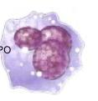
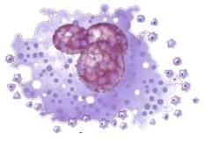

Pacritinib (PAC): A Selective Inhibitor of JAK2 and IRAK1
JAK1i
JAK and FLT3 Kinases IC₅₀ (nM)
Kinase | Pacritinib | Ruxolitinib | Fedratinib
JAK1 | 1280 | 3.4 | 18
JAK2 | 6.0 | 0.0 | 1.1
JAK2 V617F | 9.4 | NR | NR
JAK3 | 18.3 | 2.0 | 74
FLT3 | 14.8 | >3000 | 13
Immature
Megakaryocyte
Mature
Megakaryocyte
Blood
Platelets
JAK1/2i
Non-Tyrosine Kinases of Interest IC₅₀ (nM)
Kinase | Pacritinib | Ruxolitinib | Fedratinib
CSF1R | 39.5 | >3000 | 220
IRAK1 | 13.6 | 290 | 620
JAK1/2 inhibitors impair megakaryopoiesis while preserving thrombopoiesis, whereas JAK1 inhibition impairs both megakaryopoiesis and platelet release in vitro and can exacerbate thrombocytopenia in MF.ª
Minimal JAK1 inhibition uniquely positions pacritinib for use in thrombocytopenic MF patients.
Only pacritinib is a potent inhibitor of IRAK1
Eurofins “KINOMEscan” for RUX and FED
J Exp Pharm publication for PAC
Leukemia publication for PAC (JAK1)
IC₅₀, half-maximal inhibitory concentration; JAK, Janus kinase; TYK, tyrosine kinase; FLT, FMS-like tyrosine kinase; ITD, internal tandem duplication; CSF1R, colony stimulating factor 1 receptor; IRAK, interleukin-1 receptor-associated kinase
ªJadwiga J, et. al. Blood (2018) 132 (Supplement 1): 2559. Mascarenhas JO, et. al. Haematologica. 2017; 102(2):327.
Singer et al. ASH, 2014, Abstract 1874.
Notes:
IRAK1 is critical in inflammasome signaling. Inhibition of IRAK1 suppresses IL-1, TNFalpha, IL-6, IL17 and TGF beta among other inflammatory cytokines

Slide 20
Pacritinib (PAC): Mechanism of Action
JAK1-sparing, inhibitor of JAK2 and IRAK1¹⁻⁶
JAK/STAT pathway
TLR/IL-1R Myddosome pathway
JAK2/
JAK2^{V617F}
JAK1
IRAK1
STAT
Phosphorylation
STAT
STAT
NFκB
MPN
Pathogenesis
Phosphorylation
Phosphorylation
Transcription
Proinflammatory
Cytokines
Hematopoietic
Growth Factors
Proinflammatory
Cytokines
Splenomegaly
Cytopenias
Fibrosis
References in notes.
Notes:
1. Jarocha J, et al. Blood. 2018;132(Supplement 1):2559; 2. Mascarenhas JO, et al. Haematologica. 2017;102(2):327-335; 3. Singer J, et al. Comprehensive Kinase Profile of Pacritinib, a Non-Myelosuppressive JAK2 Kinase Inhibitor in Phase 3 Development in Primary and Post ET/PV Myelofibrosis (#1874). Oral presentation at: American Society of Hematology (ASH) Annual Meeting; December 6, 2014; San Francisco, CA; 4. Fisher DAC, et al. Leukemia. 2019;33(8):1978-1995; 5. Lai HY, et al. Blood Adv. 2019;3(2):122-131; 6. Balka KR, De Nardo D. J Leukoc Biol. 2019;105(2):339-351.

Slide 21
Quick 10
Ten things for MF patients to know about the approval of Pacritinib
How does MF impact afflicted patients?
How do we treat MF currently?
What are unmet needs in current treatment of MF?
What is Pacritinib?
What trials were done with Pacritinib in MF? Side Effects?

Slide 22
Pacritinib FDA Approved (MF)
February 28th, 2022

Slide 23
Phase 3 Myelofibrosis Studies in First- and Second-Line Therapy
PERSIST-1¹ 1L Therapy
Patient Population:
PMF, PET-MF, PPV-MF
Any platelet count
No prior JAK2 inhibitors
Pacritinib
400 mg QD
Primary endpoint
(Week 24)
≥35% SVR
2:1
Randomization
N=327
Best available therapy
(BAT) excl ruxolitinib (RUX)
PERSIST-2² 1L & 2L Therapy
Pacritinib
400 mg QD
Patient Population:
PMF, PET-MF, PPV-MF
Platelets ≤100,000/µL
Prior/current JAK2 inhibitors allowed
Co-primary endpoints
(Week 24)
≥35% SVR
≥50% TSSª reduction
1:1:1
Randomization
N=311
Pacritinib
200 mg BiD
BAT^{b}
(incl RUX, 45%)
PET-MF, post-essential thrombocythemia MF; L, line; PMF, primary myelofibrosis; PPV-MF, post-polycythemia vera MF; QD, once daily; SVR, spleen volume reduction; TSS, Total Symptom Score
ªTSS, total symptom score by MPN-SAF 2.0; ^{b}BAT includes RUX (45%)
1. Mesa RA, et al. Lancet Haematol. 2017;4:e225-36 2. Mascarenhas J, et al. JAMA Oncology. 2018;4:652-659.

Slide 24
PERSIST-2
≥ 35% SVR
BID, twice daily; QD, daily.
Mascarenhas J, et al. JAMA Oncol. 2018;4:652-659.
Notes:
Fig 2 A

Slide 25
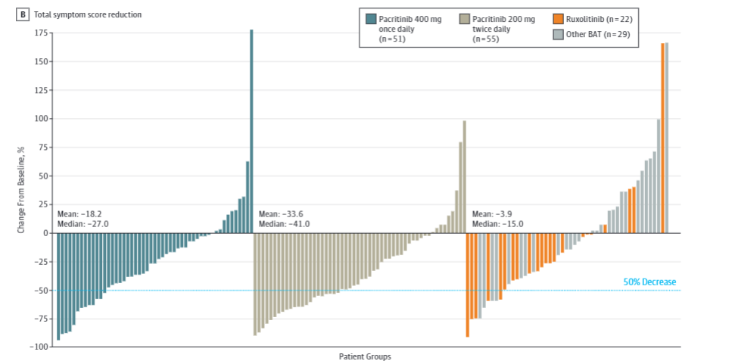
PERSIST-2
≥ 50% Reduction in TSS
Mascarenhas J, et al. JAMA Oncol. 2018;4:652-659.
Notes:
CAR: Possible to enlarge this fig to align with the one on previous slide and make it easier to read?

Slide 26
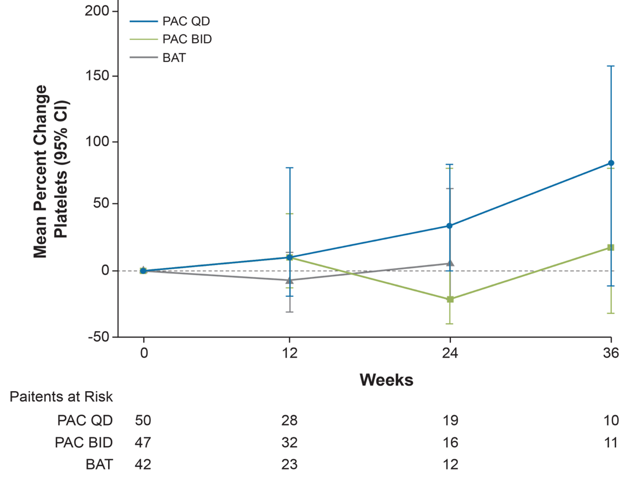
PERSIST-2 Percent Change in PLT Count
BL PLT Count < 50,000/µL*
*Based on central laboratory values.
Mascarenhas J, et al. JAMA Oncol. 2018;4:652-659.
Notes:
Image from Suppl eFigure7
CAR: Add volume/units to PAC QD/BID & BAT as per source figure?
CAR: Asterisk footnote is not included on source, ok to use here?

Slide 27
PERSIST-2
Improvement in Transfusions
RBC transfusion units/month, median
2.5
Pacritinib 200 mg BID (n = 107) BAT (n = 100)
2.25
Transfusion rate stable/decreasing over time among pacritinib 200 mg twice daily patients who received any transfusion on study
2
1.71
1.5
1.33
1.06
BAT group included
ruxolitinib (45%)
1
0.74
0.67
0.5
0
Baseline Week 12
n: 71 55 57 42
Week 24
40 27
Mascarenhas J, et al. JAMA Oncol. 2018;4:652-659.

Slide 28
Pacritinib Safety Profile: Predictable and Manageable
Median baseline platelet and Hgb levels in this population were:
  9.5g/dL Hb
  55x10⁹/L platelets
Diarrhea was generally observed within the first few weeks and was manageable with loperamide (Gr 1: 29%; Gr 2: 15.1%)
3% experienced a dose interruption as a result of diarrhea
15% discontinued treatment due to an adverse reaction, which in part was due to anemia (3%) and thrombocytopenia (2%)
Pacritinib should not be initiated in patients with an active bleed and it should be discontinued 7 days prior to any surgery
PERSIST-2 Pacritinib 200 mg BID, (N=106) | PERSIST-2²
 | All Grades, % | Grade >3, %
Diarrhea | 48.1 | 3.8
Thrombocytopenia | 34.0 | 32.1
Nausea | 32.1 | 0.9
Fatigue | 17.0 | 2.8
Abdominal pain | 9.4 | 0.9
Pyrexia | 15.1 | 0.9
Anemia | 23.6 | 21.7
Peripheral edema | 19.8 | 0.9
Decreased appetite | 12.3 | 0
Data on file

Slide 29
PACIFICA
PAC Phase 3
Key Eligibility Criteria
PMF or secondary MF
PLT count < 50 × 10⁹/L
DIPSS Int-1, -2, or high-risk disease
Palpable splenomegaly ≥ 5 cm
TSS ≥ 10 on MPN-SAF TSS 2.0
ECOG PS 0-2
Prior JAKi for ≤ 90 d allowed (or low-dose RUX for ≤ 180 d)
Primary Endpoint:
SVR at 24 wk
Secondary Endpoints:
TSS at 24 wk
OS
PGIC at 24 wk
PAC
200 mg twice daily
2:1 Randomization (N = 348)
Physician’s choice*†
Enrollment ongoing
*Physician’s choice includes any 1 of the following: low-dose RUX, corticosteroids, HU, danazol. Investigators can select individual physician's choice agents but cannot combine agents or give them sequentially.
†Crossover not permitted.
HU, hydroxyurea.
ClinicalTrials.gov. Accessed August 19, 2021. https://clinicaltrials.gov/ct2/show/NCT03165734
Notes:
ClinicalTrials.gov. A phase 3 study of pacritinib in patients with primary myelofibrosis, post polycythemia vera myelofibrosis, or post-essential thrombocythemia myelofibrosis (PACIFICA). NCT03165734. Accessed August 19, 2021. https://clinicaltrials.gov/ct2/show/NCT03165734
CAR: Please check N=168. Ref states 'Approximately 348 patients in total will be enrolled, randomized 2:1 to either pacritinib (approximately 232 patients) or to P/C therapy (approximately 116 patients)

Slide 30
Pacritinib Is a Potent ACVR1 Inhibitor with Significant Anemia Benefit in Patients with Myelofibrosis
Session 634. Myeloproliferative Syndromes: Clinical and Epidemiological: Towards Personalized Medicine in Myeloproliferative Neoplasms and Mastocytosis: New and Repurposed Drugs for Unmet Clinical Needs
Dec 11, 2022, #628

Slide 31
Pacritinib in Cytopenic Myelofibrosis
Approved in patients with MF who have a platelet count <50x10⁹/L
Able to be administered at the full approved dose (200 mg BID) regardless of cytopenias¹⁻³
Demonstrated hemoglobin improvement in randomized PERSIST-2 study²
The mechanism behind / extent of anemia benefit has not been fully described
Clinical Improvement in Hemoglobin²
PERSIST-2, Week 24
Percentage of Patients
IWG criteria: among patients with baseline hemoglobin <10 g/dL, increase of ≥2.0 g/dL or RBC transfusion independence for ≥8 weeks
BAT=best available therapy; BID=twice daily; IWG= ; MF=myelofibrosis; RBC=red blood cell.
[1] Mesa R, et al. Lancet Oncology; 2017. [2] Mascarenhas J, et al. JAMA Oncol. 2018;4(5):652-659. [3] Gerds A, et al. Blood Advances. 2020;4(22):5825-35.
Abstract 628 ASH 2022
31

Slide 32
Pacritinib is a Potent ACVR1 Inhibitor
Pacritinib is ~4x more potent than momelotinib against ACVR1
 | + Control LDN 193189ª | PAC C_{max} 213 nM | MMB C_{max} 168 nM | FED C_{max} 275 nM | RUX C_{max} 47 nM
Replicate 1 ACVR1 IC₅₀ (nM) | 20.4 | 22.6 | 70.2 | 312.0 | >1000
Replicate 2 ACVR1 IC₅₀ (nM) | 32.4 | 10.8 | 34.9 | 235.0 | >1000
Mean ACVR1 IC₅₀ (nM) | 26.4 | 16.7 | 52.6 | 273.5 | >1000
Potency^{b} (C_{max}:IC₅₀) | N/A | 12.7 | 3.2 | 1.0 | <0.01
Legend
Higher potency
Lower potency
ªLDN 193189 is an ACVR1 inhibitor.
^{b}C_{max} is the maximum unbound plasma concentration at the clinical recommended dose in humans.
ACVR1= Activin A receptor type 1; FED=fedratinib; IC₅₀=half maximal inhibitory concentration; MOM=momelotinib; PAC=pacritinib; RUX=ruxolitinib.
Abstract 628 ASH 2022
32

Slide 33
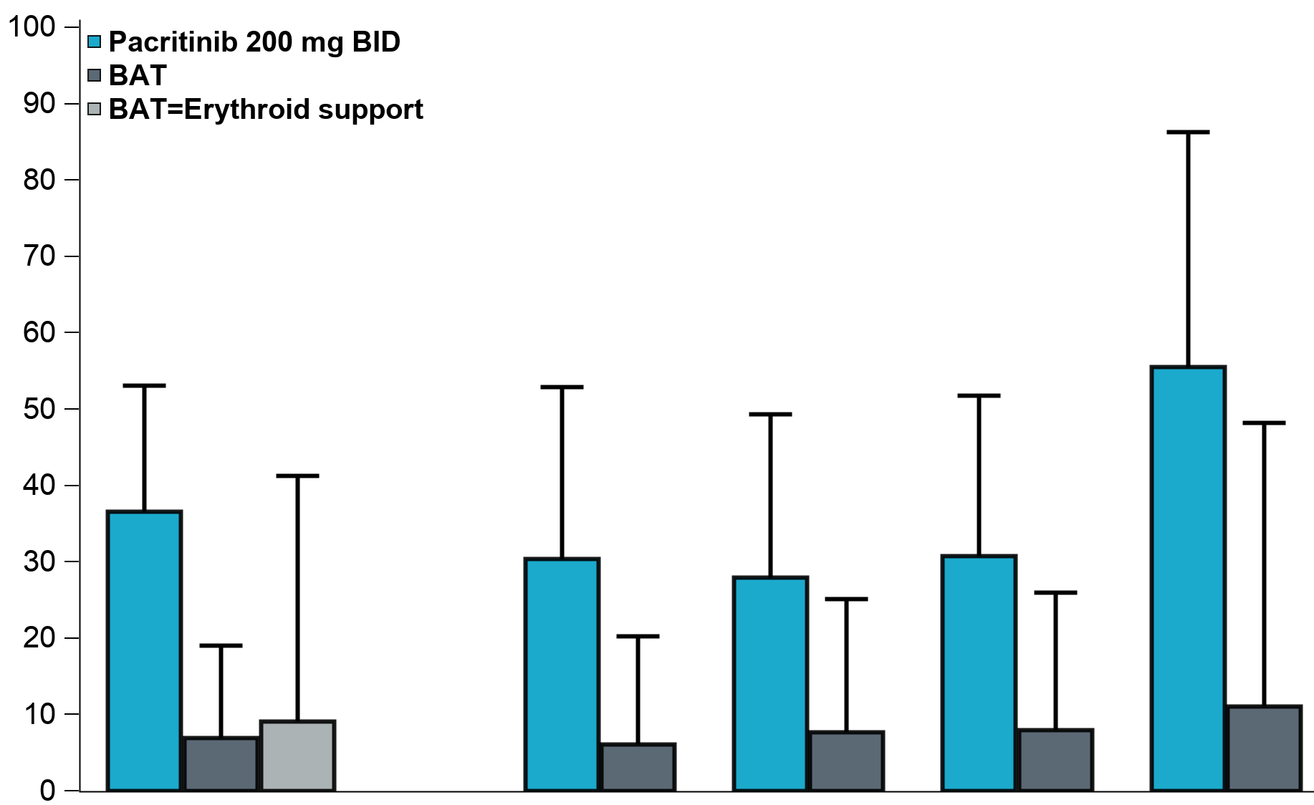
More Pacritinib Patients Achieved TI
TI Conversion Rate
Rate of TI (Gale criteria) through Week 24
TI conversion better on pacritinib than BAT, including patients receiving erythroid support agents as BAT
  Erythroid support agents were prohibited on the pacritinib arm
Pacritinib N=41 | BAT N=43 | P-value
37% | 7% | 0.001
P=0.001
Percentage of Patients
95% CI upper bound
Overall
41 PAC,
43 BAT,
11 BAT=ES
Excluding
recent RUX
23 PAC
33 BAT
PLT <50
25 PAC
26 BAT
JAK2
AB <50%
26 PAC
25 BAT
JAK2
AB ≥50%
9 PAC
9 BAT
AB=allele burden; BAT=best available therapy; ES=erythroid support; JAK=Janus associated kinase; PAC=pacritinib; PLT=platelets; recent RUX=no ruxolitinib in prior 30 days; TI=transfusion independence.
Abstract 628 ASH 2022
33

Slide 34
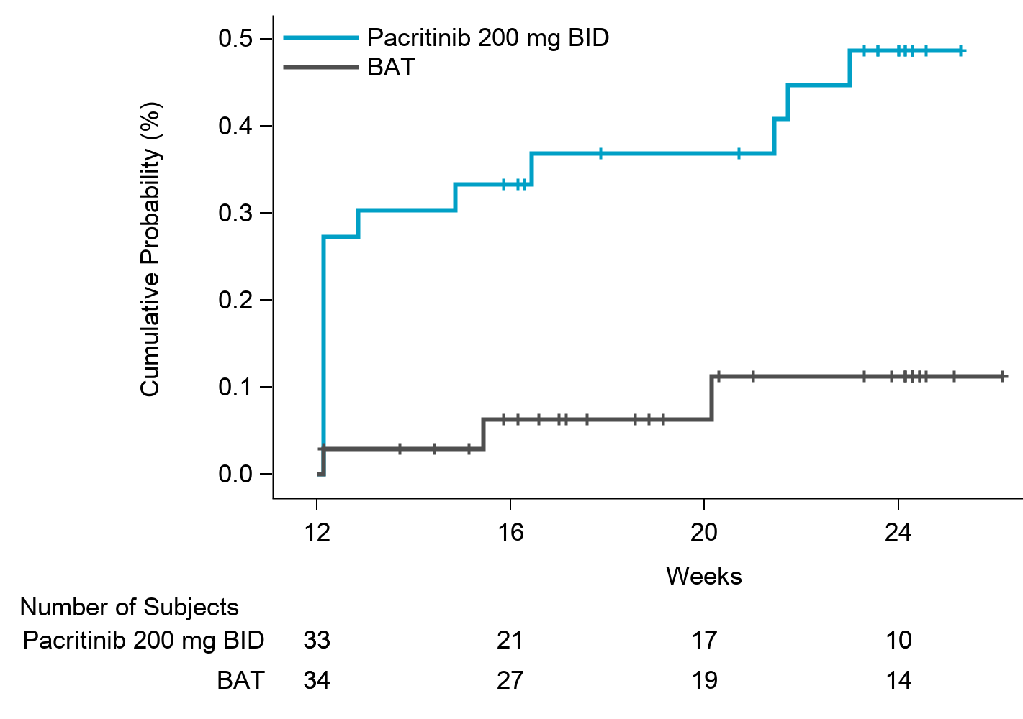
TI Conversion Can Occur Late in Treatment
Many responses occurred early during treatment
Some responses occurred after several months on treatment
Cumulative Incidence of TI (Gale criteria)
BAT=best available therapy; BID=twice daily; TI=transfusion independence.
Abstract 628 ASH 2022
34

Slide 35
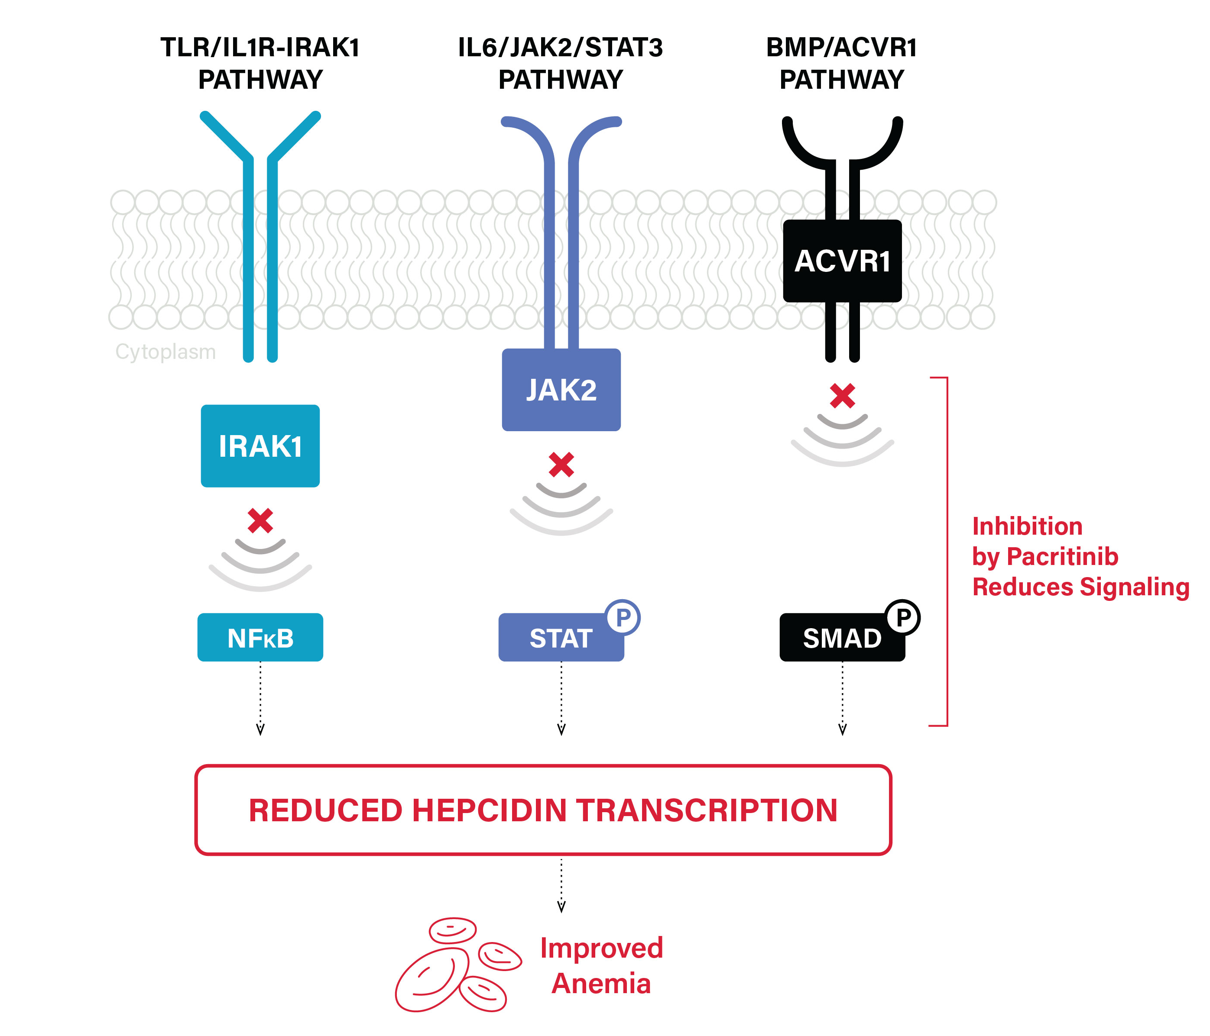
Hypothesized Mechanism of Anemia Benefit
Potent, 24-hour inhibition of ACVR1 may function in conjunction with IRAK1 and JAK2 inhibition to reduce levels of hepcidin
Hepcidin reduction ameliorates anemia of inflammation that occurs in myelofibrosis
ACVR1= Activin A receptor type 1; JAK2=Janus associated kinase 2; IL6=interleukin-6; IRAK=interleukin receptor-associated kinase.
.
Abstract 628 ASH 2022
35

Slide 36
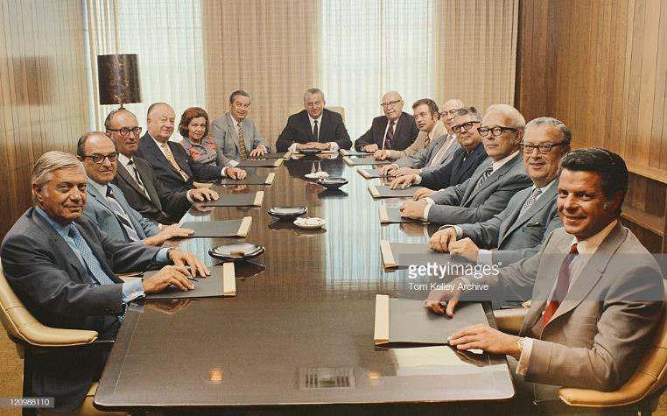
What Is a Treatment Guideline?
Guideline – Guardrails
The science of medicine
NCCN
How applied to an individual
The art of medicine

Slide 37
NCCN Guidelines® Summary:
Treatment For Myelofibrosis
Risk | Risk Stratification | Treatment Options
Lower-Risk | MIPSS-70 ≤3 MIPSS-70+ Version 2.0: ≤3 DIPSS-Plus: ≤1 DIPSS: ≤2 MYSEC-PM: <14 | Clinical trial Observation Useful in certain circumstances: Ruxolitinib Peginterferon alfa-2a Hydroxyurea, if cytoreduction would be symptomatically beneficial
Higher-Risk | MIPSS-70 ≥4 MIPSS-70+ Version 2.0: ≥4 DIPSS-Plus: >1 DIPSS: >2 MYSEC-PM: ≥14 | Transplant candidate | Allogeneic HCT
 |  | Platelets <50 x 10⁹/L | Pacritinib or Trial
 |  | Platelets ≥50 x 10⁹/L | Ruxolitinib Fedratinib Clinical trial No response or loss of response: Fedratinib (for patients previously treated with ruxolitinib), Pacritinib PLT <50 x 10(9)/L
DIPSS, dynamic international prognostic scoring system; EPO, erythropoietin; ESAs, erythropoiesis-stimulating agents; HCT, hematopoietic stem cell transplantation; MIPSS, mutation-enhanced international prognostic scoring system; NCCN, National Comprehensive Cancer Network; MYSEC-PM, Myelofibrosis secondary to PV and ET-prognostic model; RBC, red blood cell.
Gerds et al. NCCN Guidelines. Myeloproliferative Neoplasms. Version 1.2020.
Notes:
Gerds AT, Gotlib J, Bose P, et al. NCCN Clinical Practice Guidelines in Oncology (NCCN Guidelines®). Myeloproliferative Neoplasms. Version 1.2020. © 2020 National Comprehensive Cancer Network, Inc. https://www.nccn.org/professionals/physician_gls/pdf/mpn.pdf.

Slide 38
Quick 10
Ten things for MF patients to know about the approval of Pacritinib
How does MF impact afflicted patients?
How do we treat MF currently?
What are unmet needs in current treatment of MF?
What is Pacritinib?
What trials were done with Pacritinib in MF? Side Effects?
What does it mean to be FDA approved?

Slide 39
Quick 10
Ten things for MF patients to know about the approval of Pacritinib
How does MF impact afflicted patients?
How do we treat MF currently?
What are unmet needs in current treatment of MF?
What is Pacritinib?
What trials were done with Pacritinib in MF? Side Effects?
What does it mean to be FDA approved?
How does Pacritinib fit into treatment options for MF?

Slide 40
NCCN Guidelines® Summary:
Treatment For Myelofibrosis
Risk | Risk Stratification | Treatment Options
Lower-Risk | MIPSS-70 ≤3 MIPSS-70+ Version 2.0: ≤3 DIPSS-Plus: ≤1 DIPSS: ≤2 MYSEC-PM: <14 | Clinical trial Observation Useful in certain circumstances: Ruxolitinib Peginterferon alfa-2a Hydroxyurea, if cytoreduction would be symptomatically beneficial
Higher-Risk | MIPSS-70 ≥4 MIPSS-70+ Version 2.0: ≥4 DIPSS-Plus: >1 DIPSS: >2 MYSEC-PM: ≥14 | Transplant candidate | Allogeneic HCT
 |  | Platelets <50 x 10⁹/L | Pacritinib or Trial
 |  | Platelets ≥50 x 10⁹/L | Ruxolitinib Fedratinib Clinical trial No response or loss of response: Fedratinib (for patients previously treated with ruxolitinib), Pacritinib PLT <50 x 10(9)/L
DIPSS, dynamic international prognostic scoring system; EPO, erythropoietin; ESAs, erythropoiesis-stimulating agents; HCT, hematopoietic stem cell transplantation; MIPSS, mutation-enhanced international prognostic scoring system; NCCN, National Comprehensive Cancer Network; MYSEC-PM, Myelofibrosis secondary to PV and ET-prognostic model; RBC, red blood cell.
Gerds et al. NCCN Guidelines. Myeloproliferative Neoplasms. Version 1.2020.
Notes:
Gerds AT, Gotlib J, Bose P, et al. NCCN Clinical Practice Guidelines in Oncology (NCCN Guidelines®). Myeloproliferative Neoplasms. Version 1.2020. © 2020 National Comprehensive Cancer Network, Inc. https://www.nccn.org/professionals/physician_gls/pdf/mpn.pdf.

Slide 41
Quick 10
Ten things for MF patients to know about the approval of Pacritinib
How does MF impact afflicted patients?
How do we treat MF currently?
What are unmet needs in current treatment of MF?
What is Pacritinib?
What trials were done with Pacritinib in MF? Side Effects?
What does it mean to be FDA approved?
How does Pacritinib fit into treatment options for MF?
I am already on a treatment for MF, should I switch?

Slide 42
Quick 10
Ten things for MF patients to know about the approval of Pacritinib
How does MF impact afflicted patients?
How do we treat MF currently?
What are unmet needs in current treatment of MF?
What is Pacritinib?
What trials were done with Pacritinib in MF? Side Effects?
What does it mean to be FDA approved?
How does Pacritinib fit into treatment options for MF?
I am already on a treatment for MF, should I switch?
I have PV or ET, should I start Pacritinib?

Slide 43
Quick 10
Ten things for MF patients to know about the approval of Pacritinib
How does MF impact afflicted patients?
How do we treat MF currently?
What are unmet needs in current treatment of MF?
What is Pacritinib?
What trials were done with Pacritinib in MF? Side Effects?
What does it mean to be FDA approved?
How does Pacritinib fit into treatment options for MF?
I am already on a treatment for MF, should I switch?
I have PV or ET, should I start Pacritinib?
What dose of Pacritinib should I take and how do I start the medication?

Slide 44
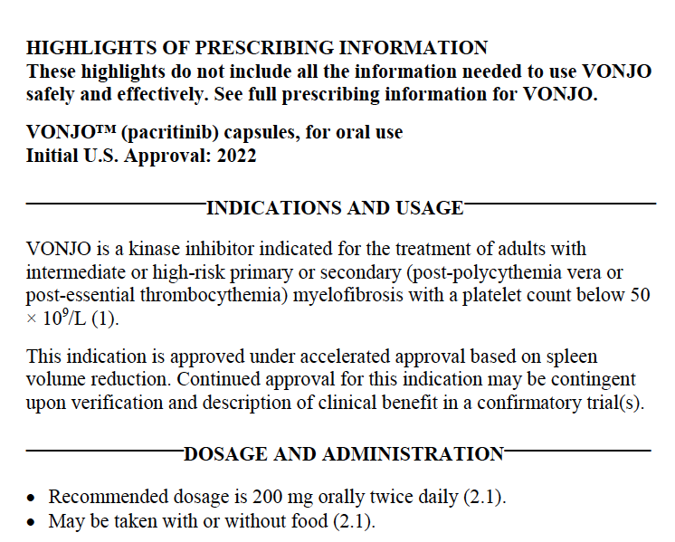
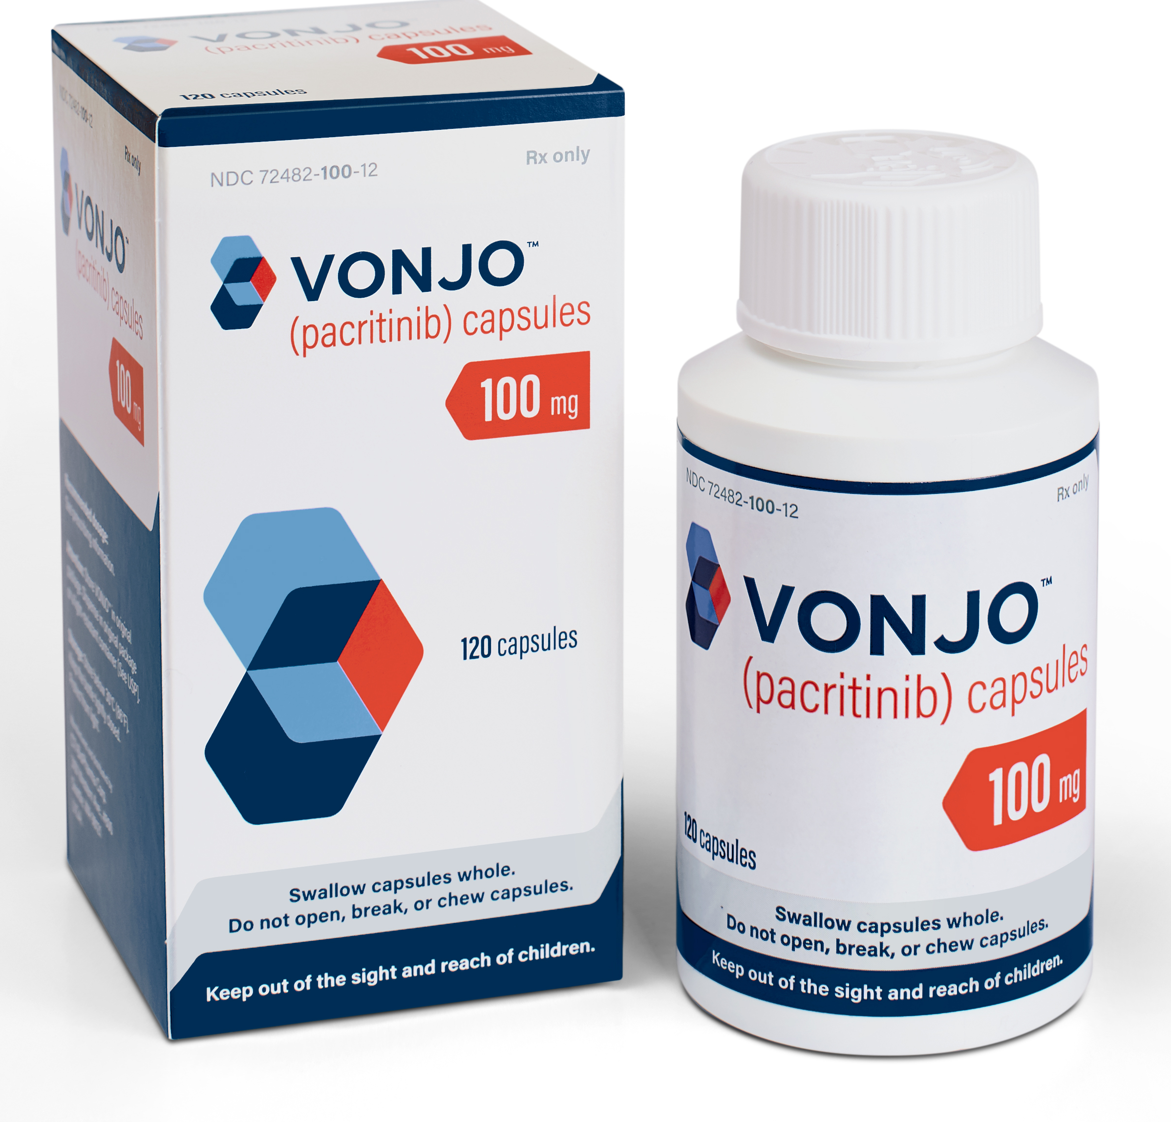
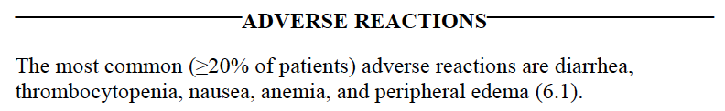
Now Approved Pacritinib (Vonjo)

Slide 45
MPN Patient Community
MPN Group | Focus | Website
MPN Research Foundation | RES-ED-ADV | www.Mpnresearchfoundation.org
Leukemia and Lymphoma Society* | RES-ED-ADV | www.lls.org
MPN Advocacy & Education International* | ED-ADV | www.mpnadvocacy.com
MPN Education Foundation* | ED-COMM | www.mpninfo.org
AAMDS Foundation | ED | www.aamds.org
MPN Voice | ED | www.mpnvoice.org.uk
MPN HUB* | ED | www.mpn-hub.com
MPN Advocates Network | ED-ADV | www.mpn-advocates.net
Global MPN Scientific Foundation* | RES-ED-ADV | www.gmpnsf.org
MPN Forum Facebook Group | ED-COMM | https://www.facebook.com/groups/ourmpnforum/

