Slide 1
Management of Anemia in Myelofibrosis
Prithviraj Bose, MD
Associate Professor, Department of Leukemia
University of Texas MD AndersonCancer Center
MPN Clinical Roadmap, March 2023

Slide 2
Anemia Is a Common Manifestation of Myelofibrosis
During their disease course/treatment, virtually all patients with myelofibrosis will experience anemia^{1,a}
Prevalence of Anemia in Patients With Myelofibrosis Rises Over Time^{1,2}
~100%
~60%
~35%
Patients With Anemia (%)
Time From Diagnosis
At diagnosis
Within 1 year^{b}
During the disease course
ª Anemia defined as hemoglobin <10 g/dL. ^{b} Anemia from time of diagnosis among 1000 Mayo Clinic patients with primary myelofibrosis.
1. Naymagon L, et al. Hemasphere. 2017;1(1):e1. 2. Tefferi A, et al. Mayo Clin Proc. 2012;87(1):25-33.

Slide 3
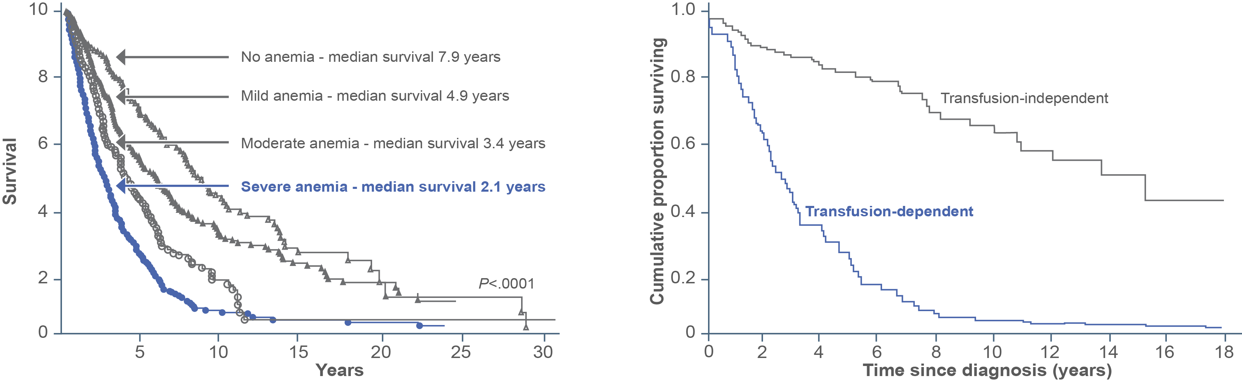
Anemia and RBC Transfusion Are Indicators of Poor Prognosis
Current prognostic modelsª acknowledge anemia and RBC transfusion needs as risk factors¹⁻³
Overall Survival by Degree of Anemia^{4,b}
Overall Survival by Transfusion Dependency^{5,c}
P<0.0001
ª IPSS, DIPSS, and DIPSS plus for anemia; DIPSS plus for transfusion needs; anemia defined as hemoglobin <10 g/dL. ^{b} Survival data in 1109 patients with primary myelofibrosis diagnosed at a single location. ^{c} Overall survival in 220 patients with primary myelofibrosis diagnosed at a single location.
1. Cervantes F, et al. Blood. 2009;113(13):2895-2901. 2. Passamonti F, et al. Blood. 2010;115(9):1703-1708. 3. Tefferi A, et al. Mayo Clin Proc. 2012;87(1):25-33.
4. Nicolosi M, et al. Leukemia. 2018;32(5):1254-1258. 5. Elena C, et al. Haematologica. 2011;96(1):167-170.

Slide 4
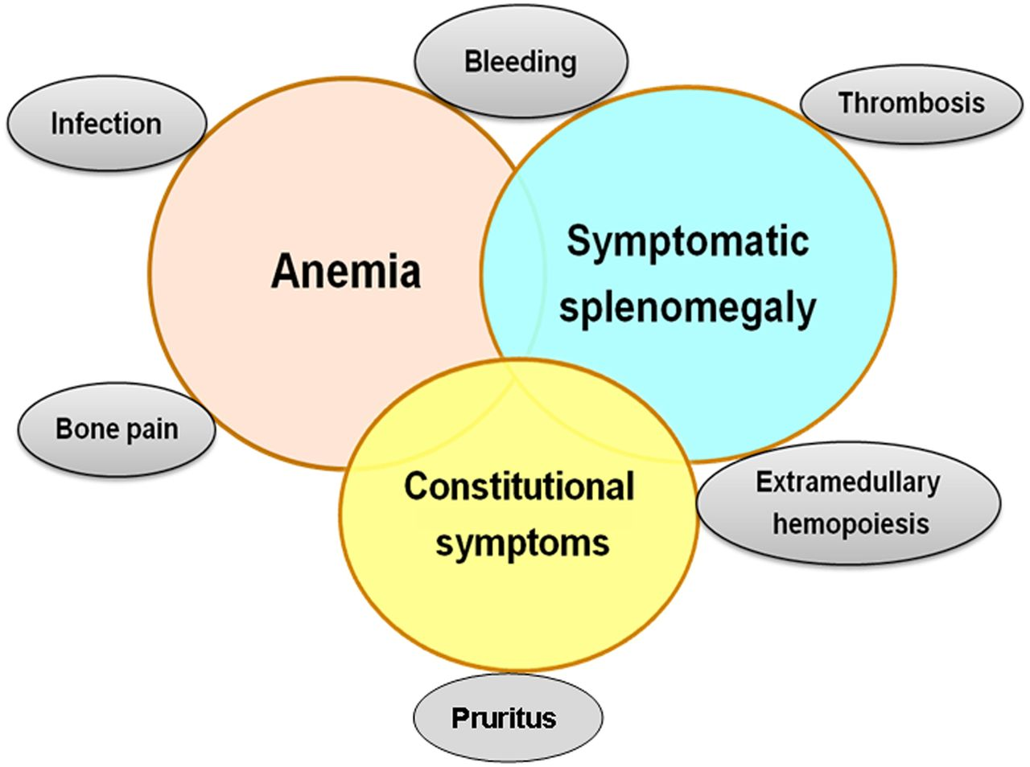
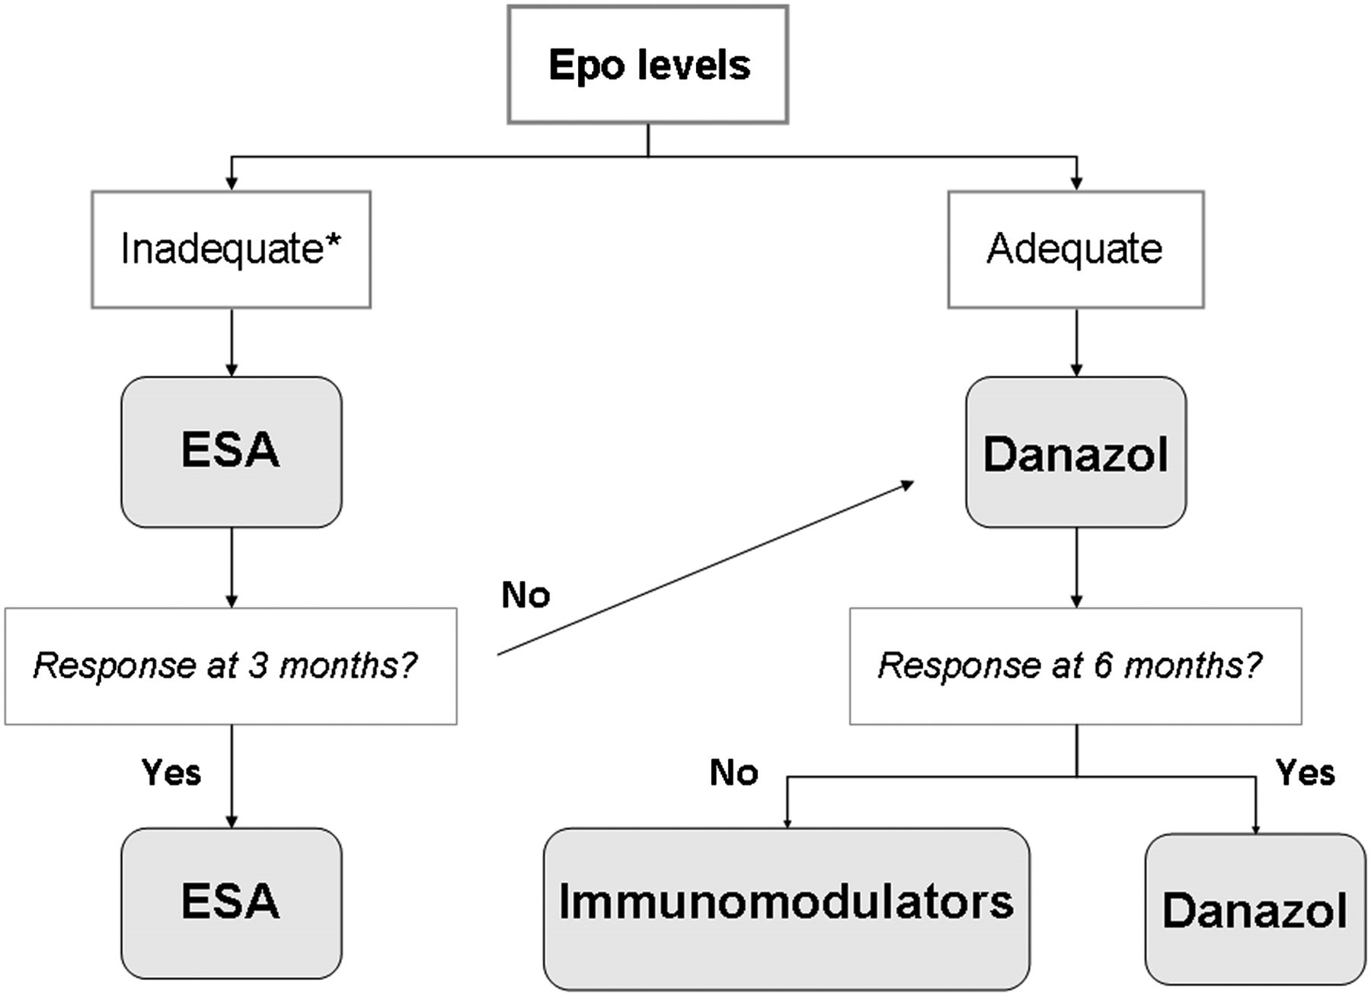

Francisco Cervantes, How I treat myelofibrosis, Blood, 2014, Figure 2
Copyright © 2020 American Society of Hematology
Notes:
Figure Legend:
Treatment algorithm for the anemia of MF. *<125 mU/mL.

Slide 5
Drug Therapy for Anemia of MF
Danazol:
  ORR 37% in 30 pts; median time to response 5 months
  Caveat: hepatotoxicity and liver tumors, prostate cancer
ESAs:
  Response rates of 40–60% in small studies (about 20 cases)
  Response rate of 53% (Spanish study, 193 pts) with response duration of 19.3 months. Factors associated with higher RR were female, WBC ≥ 10 x 10⁹ /L, serum ferritin < 200 ng/mL
IMID agents ± prednisone
  Mostly 20–35% response rates (up to 62%)
  Low-dose thalidomide (50 mg/d) better tolerated
ESA, erythropoiesis‑stimulating agent; IMID, immunomodulatory drug; MF, myelofibrosis; ORR, overall response rate; pt, patients; RR, response rate; WBC, white blood cell.
1. Hernández-Boluda J-C, et al. Eur J Haematol. 2017;98:407–414; 2. Cervantes F, et al. Br J Haematol. 2004;127:399–403; 3. Cervantes F, et al. Br J Haematol. 2005;129:771–775; 4. Cervantes F, et al. Br J Haematol. 2006;134:184–186; 5. Cervantes F, et al. Blood. 2014;124:2635–2642; 6. Tsiara SN, et al. Acta Haematol. 2007;117:156–161; 7. Mesa RA, et al. Blood. 2003;101:2534–2541; 8. Marchetti M, et al. J Clin Oncol. 2004;22:424–431; 9. Weinkove R, et al. Haematologica. 2008;93:1100-1101; 10. Tefferi A, et al. Blood. 2006;108:1497–1503; 11. Mesa RA, et al. Blood. 2010;116:4436–4438; 12. Chihara D, et al. Leuk Res. 2016;48:1–5; 13. Barosi G, et al. Leuk Lymphoma. 2002;43:2301–2307; 14. Tefferi A, et al. J Clin Oncol. 2009;27:4563–4569; 15. Tefferi A, et al. Leukemia. 2017;31:896–902; 16. Daver N, et al. Leuk Res. 2013;37:1440–1444; 17. Daver N, et al. Leuk Res. 2014;38:1126–1129; 18. Begna KH, et al. Leukemia. 2011;25:301–304. Slide courtesy Francesco Passamonti

Slide 6
Luspatercept reduces the inhibitory effects of TGF-β superfamily ligand signaling via ActRIIB
Luspatercept
ActRIIB
Cytoplasm
Smad2/3
Smad4
Nucleus
Erythroid differentiation not blocked
ActRIIB, activin receptor type IIB; TGF-β, transforming growth factor beta
6

Slide 7

Luspatercept for Treating Anemia in MF
Open-label, nonrandomized, multicohort phase II trial of luspatercept 1 mg/kg every
21 days for patients with primary or post-ET/
post-PV MF and anemia (planned N = 100)
Not receiving
ruxolitinib
Receiving ruxolitinib‡
No RBC
transfusions
Cohort 1
(n = 22)
Cohort 3A
(n = 14)
Study Cohorts
RBC transfusion
dependent
Cohort 2
(n = 21)
Cohort 3B
(n = 19)
Parameter | RBC Transfusion Dependent
 | No RUX (Cohort 2; n = 21) | RUX (Cohort 3b; n = 19)
RBC transfusion-free ≥ 12 consecutive wks, n (%)* | 2 (10) | 6 (32)
Median duration of response, wks (range) | 32 (16-49) | 39 (12-77)
≥ 50% reduction in RBC transfusion burden from BL, n (%) | 8 (38) | 10 (53)
Hb Increase ≥ 1.5 g/dL From BL for ≥ 12 Consecutive Wks† | No RBC Transfusions
 | No RUX (Cohort 1; n = 22) | RUX (Cohort 3a; n = 14)
Hb increase ≥ 1.5 g/dL at every assessment, n (%) | 3 (14) | 3 (21)
Mean Hb increase ≥ 1.5 g/dL, n (%) | 4 (18) | 9 (64)
*Primary endpoint, cohorts 2, 3b. †Primary endpoint, cohorts 1, 3a. ‡Stable dose for ≥ 16 wks at enrollment
Gerds AT et al. ASH 2019. Abstr 557.
Slide credit: clinicaloptions.com
Notes:
ECOG, Eastern Cooperative Oncology Group; Hb, hemoglobin; MDS, myelodysplastic syndromes; MF, myelofibrosis; PS, performance status; RBC, red blood cell.

Slide 8
Achievement of RBC-TI ≥ 12 weeks, ≥ 50% transfusion burden reduction, and multiple response episodes
Figure 2. Rates of RBC-TI and ≥ 50% transfusion burden reduction ≥ 12 weeks
46%
(n = 10)
36%
(n = 8)
37%
(n = 8)
27%
(n = 6)
19%
(n = 4)
10%
(n = 2)
a
Primary endpoint
Achievement of multiple episodes of response
Of the RBC-TI ≥ 12-week responders in both Cohorts 2 and 3B, 25% experienced 2 separate episodes of
RBC-TI ≥ 12 weeks
Of the subjects who achieved ≥ 50% reduction in RBC transfusion burden over any 12 weeks, 3 subjects in Cohort 2 (38%) and 2 subjects in Cohort 3B (20%) experienced 2 separate ≥ 12-week response episodes
  1 subject (13%) in Cohort 2 experienced 3 separate episodes of RBC-TI ≥ 12 weeks
Gerds AT et al. ASH 2020.
ªDefined as RBC transfusion burden reduction by ≥ 50% and by ≥ 4 RBC U for ≥ 12 weeks.
Notes:
For the primary endpoint, 10% and 27% of subjects receiving transfusions in Cohorts 2 and 3B achieved RBC-TI ≥ 12 weeks during Weeks 1-24
When assessing the entire treatment period, 19% and 36% of subjects in Cohorts 2 and 3B achieved RBC TI ≥ 12 weeks
A ≥ 50% reduction in RBC transfusion burden over any consecutive 12 weeks during the entire treatment period was achieved by 38% and 46% of the subjects in Cohorts 2 and 3B, respectively

Slide 9
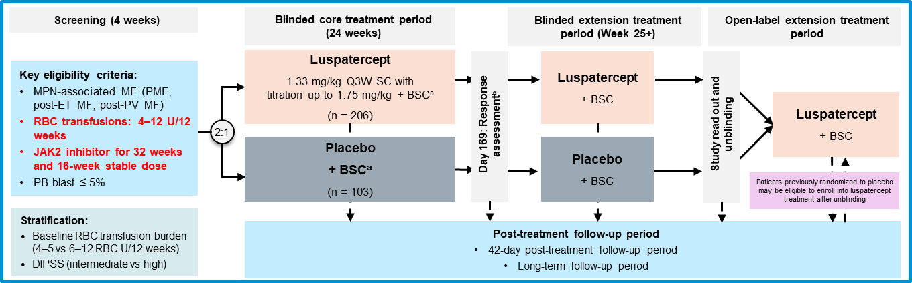
INDEPENDENCE Study Design
Phase 3, double-blind, randomized study to compare the efficacy and safety of luspatercept vs placebo in patients with MPN-associated MF on concomitant JAK2 inhibitor therapy and who require RBC transfusions
a BSC includes transfusions, ICT, antibiotic therapies and nutritional support. Therapies excluded include ESAs, androgenic steroids, thalidomide and IMiDs;
b Response assessment: continue double-blind treatment if RBC transfusion independence ≥ 12 weeks, and/or reduced RBC transfusion by ≥ 50% and ≥ 4 units ≥ 12 weeks up to response assessment. BSC, best supportive care; DIPSS, Dynamic International Prognostic Scoring System; ESA, erythropoiesis-stimulating agent; ICT, iron chelation therapy; IMiD, immunomodulatory drug; JAK2, Janus kinase 2; MF, myelofibrosis; MPN, myeloproliferative neoplasms; PB, peripheral blood; PMF, primary myelofibrosis; post-ET, post-essential thrombocythemia; post-PV, post-polycythemia vera; Q3W, every 3 weeks; RBC, red blood cell; SC, subcutaneous; U, units. INDEPENDENCE study protocol (Data on file); ClinicalTrials. NCT04717414. Available at: https://clinicaltrials.gov/ct2/show/NCT04717414.

Slide 10
The effect of ruxolitinib: Mean Platelet Count and Hemoglobin over Time COMFORT-I
Platelet Count
Hemoglobin
370
Ruxolitinib
Placebo
115
Ruxolitinib
Placebo
320
110
105
270
Mean Hemoglobin, g/L
Mean Platelets, x 10⁹/L
100
220
95
170
90
120
85
0
12
24
36
48
60
72
84
96
108
120
132
144
0
12
24
36
48
60
72
84
96
108
120
132
144
Time, wk
Time, wk
No. of Patients
No. of Patients
RUX
155
144
143
136
124
112
110
107
104
100
94
88
79
155
145
143
136
124
113
110
107
104
100
94
88
79
Placebo
151
128
112
82
37
151
132
113
83
37

Slide 11
REALISE study: alternative ruxolitinib dosing in patients with MF and anemia (Hb < 10 g/dL)
Alternative ruxolitinib dosing regimen starting at 10 mg b.i.d. for 12 weeks followed by upwards titration in the phase 2 study
100
N
Mean:
Median:
= 50
−42.07
−30.95
≥ 50% spleen length reduction | Week 24 | Any time
Patients | 56% | 70%
50
Best spleen response (% change)
from baseline
0
Week 24 spleen response was seen in both transfusion-dependent and non-transfusion-dependent patients
−50
−100
Patient
Best spleen response for individual patients
Cervantes F, et al. Poster presentation at EHA 2019; abstract PS1465; Leukemia 2021.

Slide 12
Fedratinib Adverse Events in JAKARTA
Adverse Event, % | Fedratinib 400 mg (n = 96) |  | Fedratinib 500 mg (n = 97) |  | Placebo (n = 95)
 | All Grades | Grade 3 or 4 | All Grades | Grade 3 or 4 | All Grades | Grade 3 or 4
Nonhematologic
Diarrhea | 66 | 5 | 56 | 5 | 16 | 0
Vomiting | 42 | 3 | 55 | 9 | 5 | 0
Nausea | 64 | 0 | 51 | 6 | 15 | 0
Constipation | 10 | 2 | 18 | 0 | 7 | 0
Asthenia | 9 | 2 | 16 | 4 | 6 | 1
Abdominal pain | 15 | 0 | 12 | 1 | 16 | 1
Fatigue | 16 | 6 | 10 | 5 | 1 | 0
Hematologic
Anemia | 99 | 43 | 98 | 60 | 91 | 25
Thrombocytopenia | 63 | 17 | 57 | 27 | 51 | 9
Lymphopenia | 57 | 21 | 66 | 27 | 54 | 21
Leukopenia | 47 | 6 | 53 | 16 | 19 | 3
Neutropenia | 28 | 8 | 44 | 18 | 15 | 4
Black box warning
Wernicke’s encephalopathy (ataxia, altered mental status, ophthalmoplegia) occurred in 8 of 608 (1.3%) patients receiving fedratinib in clinical trials
Considerations
Measure and address thiamine levels prior to treatment initiation
Do not start fedratinib in patients with thiamine deficiency
Pardanani A, et al. JAMA Oncol. 2015;1(5):643–651.

Slide 13








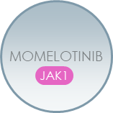
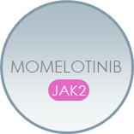


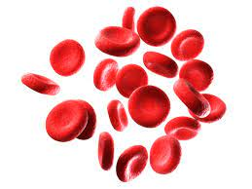



Momelotinib Inhibits JAK1, JAK2 and ACVR1 to Address MF Symptoms, Spleen, and Anemia
Interleukins
Interferons
Ligand
BMP2, BMP6
Cytokine
Receptors
ACVR1
EPOR/MPL
Hepatocyte
cellular membrane
JAK2
JAK2
JAK2
JAK1
Serum Iron,
Hemoglobin,
Erythropoiesis
Hepcidin
JAK2
Inhibition
STAT
P
STAT
P
SMAD1,5
P
Dysregulated JAK-STAT signaling in MF drives overproduction of inflammatory cytokines, bone marrow fibrosis, systemic symptoms, and clonal proliferation resulting in extramedullary hematopoiesis and splenomegaly.^{1,2}
Chronic inflammation also drives hyperactivation of ACVR1, elevated hepcidin, dysregulated iron metabolism, and anemia of MF.^{3,4}
ACVR1=activin A receptor type 1; BMP=bone morphogenic protein; EPOR=erythropoietin receptor; JAK=Janus kinase; MMB=momelotinib; MPL=myeloproliferative leukemia protein;
STAT=signal transducer and activator of transcription.
1. Chifotides HT, et al. J Hematol Oncol. 2022;15(1):7; 2. Verstovsek S, et al. Future Oncol. 2021;17(12):1449-1458; 3. Asshoff M, et al. Blood. 2017;129(13):1823-1830; 4. Oh S, et al. Blood Adv. 2020;4(18):4282-4291.

Slide 14
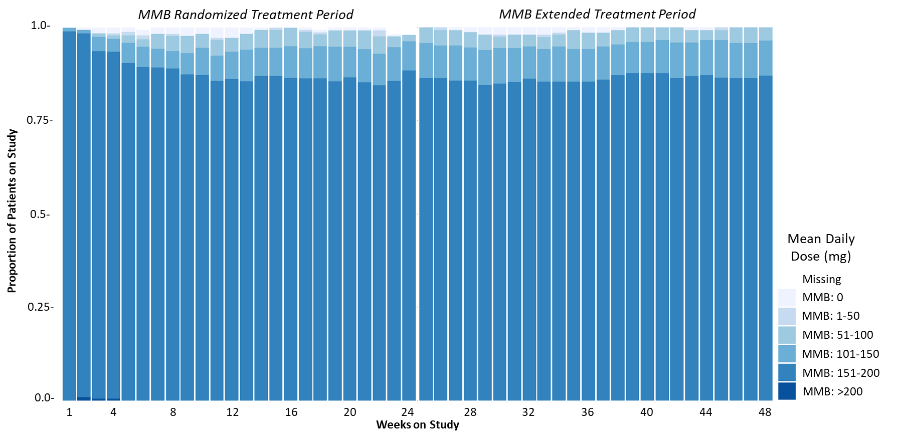
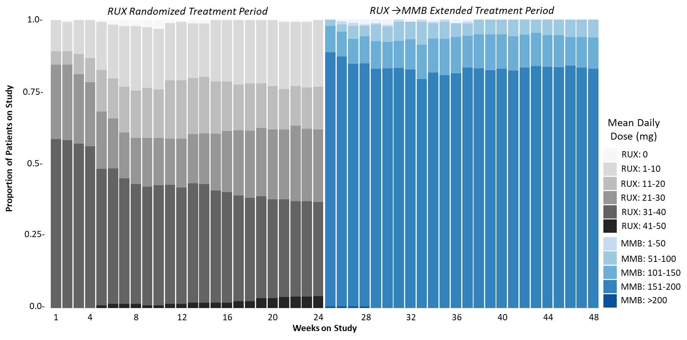
Momelotinib:
Differentiated Heme Profile Allows High Dose Intensity
Place video here
Mean Hemoglobin Levels
Average Dose Intensity by Week
SIMPLIFY-1
MMB
Proportion of Patients on Study
SIMPLIFY-1
Crossover
RUX→MMB
Mean Platelet Levels
SIMPLIFY-1
SIMPLIFY-1
RUX
Crossover
RUX→MMB
Weeks on Study
Verstovsek S et al. ASH 2020.

Slide 15
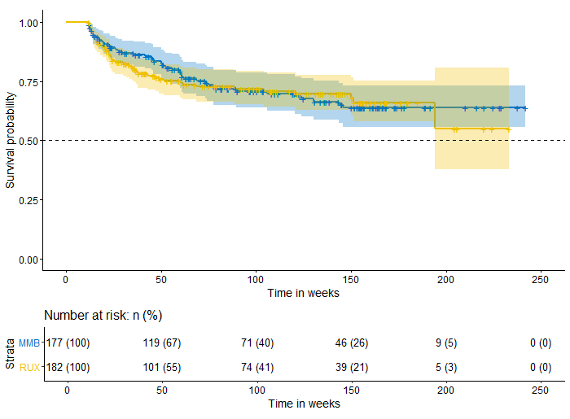
SIMPLIFY-1: Transfusion Independence and Duration of TI
Place video here
Median duration of TI not reached
>3 years follow up
SIMPLIFY-1
Nominal p<0.001
Treatment
MMB
RUX→MMB at Week 24
Verstovsek S et al. ASH 2020.

Slide 16
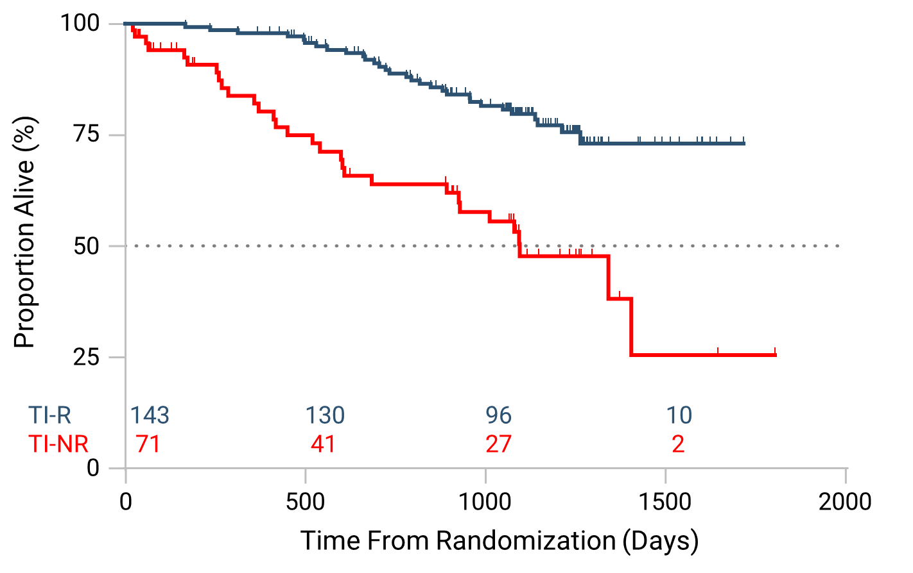
Results: SIMPLIFY-1 OS in All Patients Randomized to MMB by Week 24 TI Response
MMB-randomized TI Responder (TI-R)
HR=0.30
p<0.0001
MMB-randomized TI Nonresponder (TI-NR)
In S1, patients randomized to MMB who were TI responders at W24 show an OS advantage
3-year survival in MMB TI responders was 80% compared to 50% in MMB TI nonresponders, HR=0.30; p<0.0001
Note: Results of OS analysis measured from W24 are consistent with OS measured from randomization.
Mesa RA et al. EHA 2021

Slide 17
MOMENTUM: Transfusion Independence* Rate at W24 and Mean Hemoglobin Over Time
P=0.0064 (Noninferior)
Double-blind
Randomization Period
Open-label Period
35
11.0
31%
Momelotinib
Momelotinib
30
Danazol
Danazol → Momelotinib
10.0
25
20%
20
Mean Hemoglobin Levels (g/dL)
Transfusion Independence Rate (%)
9.0
15%
15
13%
10
8.0
5
BL
4
8
12
16
20
24
28
32
36
40
44
48
No. of Patients
Weeks since Randomization
0
Momelotinib
129
105
112
93
87
88
83
67
56
44
42
36
28
Baseline
Week 24
Baseline
Week 24
Momelotinib (N=130)
Danazol (N=65)
Danazol
65
54
50
38
36
36
29
31
21
19
18
13
7
*Defined as not requiring red blood cell transfusion in the terminal 12 weeks of the 24-week randomized period, with all hemoglobin levels during the 12-week interval of ≥8 g/dL.
Verstovsek S et al. Lancet 2023.

Slide 18
Week 24 TI Responsesª Were Sustained Through Week 48
TI Duration of Response in ITT Population
Mean Hgb Over Time in TI Responders
100
11.5
RT period
OL/Crossover
80
11.0
10.5
60
10.0
Probability, %
Hgb, g/dL
40
9.5
9.0
20
 | MMB | DAN
No. of patients | 40 | 13
Event | 4 | 3
Censor | 36 | 10
Treatment group
8.5
MMB
DAN
DAN→MMB
MMB
DAN
8.0
0
7.5
0
4
8
12
16
20
24
28
32
36
40
44
48
52
BL
4
8
12
16
20
24
28
32
36
40
44
48
Time, weeks (after week 24)
Time, weeks
MMB (n)
DAN (n)
40
13
40
13
40
13
40
13
38
12
36
12
36
11
34
11
32
10
23
9
0
1
1
1
0
MMB (n)
39
34
32
33
35
36
34
36
37
33
33
34
33
DAN (n)
13
11
12
11
11
12
10
11
11
7
10
9
10
Week 24 TI response was 31% in the MMB group and 20% in the DAN group
  Consecutive 12-week TI-R^{b} was 44.6% in the MMB group and 29.2% in the DAN group (Poster #3028)
Week 24 TI response was maintained in 36 of 40 (90%) MMB→MMB and 10 of 13 (77%) DAN→MMB patients
Gerds AT et al. ASH 2022
ªDefined as not requiring RBC transfusion in the prior 12 weeks and Hgb levels ≥8 g/dL; ^{b}Consecutive 12-week TI-R (defined as absence of RBC transfusions and no Hgb measurement below 8 g/dL over any 12-week period through week 24)​
BL, baseline; DAN, danazol; Hgb, hemoglobin; ITT, intention-to-treat; MMB, momelotinib; OL, open-label; RBC, red blood cell; RT, randomized treatment; TI, transfusion independence.

Slide 19
Pacritinib Is a Potent ACVR1 Inhibitor
Pacritinib is ~4x more potent than momelotinib against ACVR1
 | + Control LDN 193189ª | PAC C_{max} 213 nM | MMB C_{max} 168 nM | FED C_{max} 275 nM | RUX C_{max} 47 nM
Replicate 1 ACVR1 IC₅₀ (nM) | 20.4 | 22.6 | 70.2 | 312.0 | >1000
Replicate 2 ACVR1 IC₅₀ (nM) | 32.4 | 10.8 | 34.9 | 235.0 | >1000
Mean ACVR1 IC₅₀ (nM) | 26.4 | 16.7 | 52.6 | 273.5 | >1000
Potency^{b} (C_{max}:IC₅₀) | N/A | 12.7 | 3.2 | 1.0 | <0.01
Legend
Higher potency
Lower potency
ªLDN 193189 is an ACVR1 inhibitor.
^{b}C_{max} is the maximum unbound plasma concentration at the clinical recommended dose in humans.
Oh ST et al. ASH 2022
ACVR1= Activin A receptor type 1; FED=fedratinib; IC₅₀=half maximal inhibitory concentration; MOM=momelotinib; PAC=pacritinib; RUX=ruxolitinib.
19

Slide 20
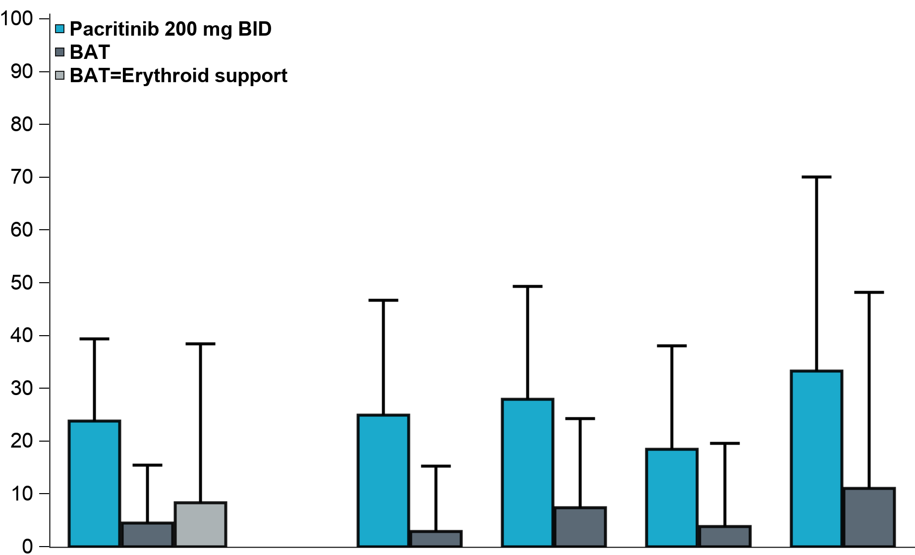
Non-TI pts in PERSIST2: More Pac Pts Achieved TI (SIMPLIFY)
TI Conversion Rate
Rate of TI (SIMPLIFY criteria) through Week 24
Pacritinib N=42 | BAT N=44 | P-value
24% | 5% | 0.013
P=0.013
TI conversion better on pacritinib than BAT, including patients receiving erythroid support agents as BAT
  Erythroid support agents were prohibited on the pacritinib arm
  By Gale criteria, 37% (pac) vs. 7% (BAT), p = 0.001
Some responses occurred after several months on treatment
≥50% reduction in transfusion burden more common on pacritinib (49% vs. 9%, p = 0.0001)
Percentage of Patients
95% CI upper bound
Overall
42 PAC,
44 BAT,
12 BAT=ES
Excluding
recent RUX
24 PAC,
34 BAT
PLT <50
25 PAC,
27 BAT
JAK2
AB <50%
27 PAC,
26 BAT
JAK2
AB ≥50%
9 PAC,
9 BAT
AB=allele burden; BAT=best available therapy; ES=erythroid support; JAK=Janus associated kinase; PAC=pacritinib; PLT=platelets; recent RUX=no ruxolitinib in prior 30 days; TI=transfusion independence.
20

Slide 21
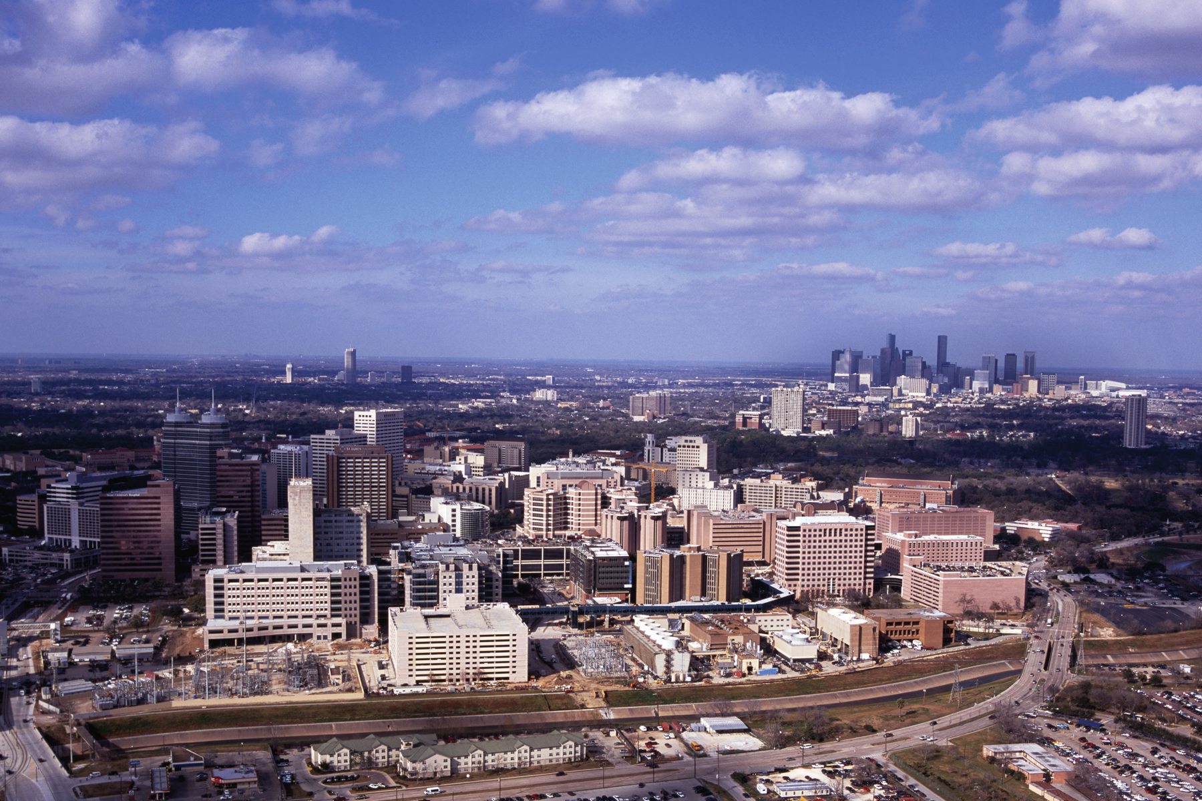
Thank you
pbose@mdanderson.org
713-792-7747

