Slide 1
Masked Polycythemia Vera What is it? What are the implications?
Laura C. Michaelis, MD
Armand J. Quick Professor of Medicine
Chief, Division of Hematology/Oncology
Medical College of Wisconsin/Froedtert Hospital

Slide 2
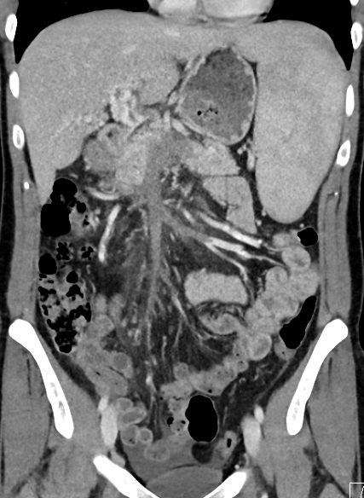
Case #1
38-yo female
Taking oral contraceptives
Presents to emergency department with central, severe abdominal pain
CT Scan with thrombosis of superior mesenteric vein
Undergoes thrombectomy, pain resolves
Is found to have the JAK2 V617F mutation
Started on anticoagulation and referred for workup and diagnosis
Notes:
Near complete occlusion of the portal-mesenteric venous system (as detailed), likely acute on chronic given cavernous transformation at the porta hepatis. Of note, the very proximal (small) ileal and jejunal territories to the SMV are still patent. 2. Normal bowel wall enhancement. 3. Splenomegaly.
EPO level is in the low normal range: 5 (range is 4-10)

Slide 3
When to Suspect a Myeloproliferative Neoplasm?
Abnormal laboratory parameters
Unexplained pruritis – especially after exposure to warm water
Recurrent fetal loss
Unusual or unexpected thromboses
Mesenteric or splanchnic thrombosis
Cerebral venous thrombosis

Slide 4
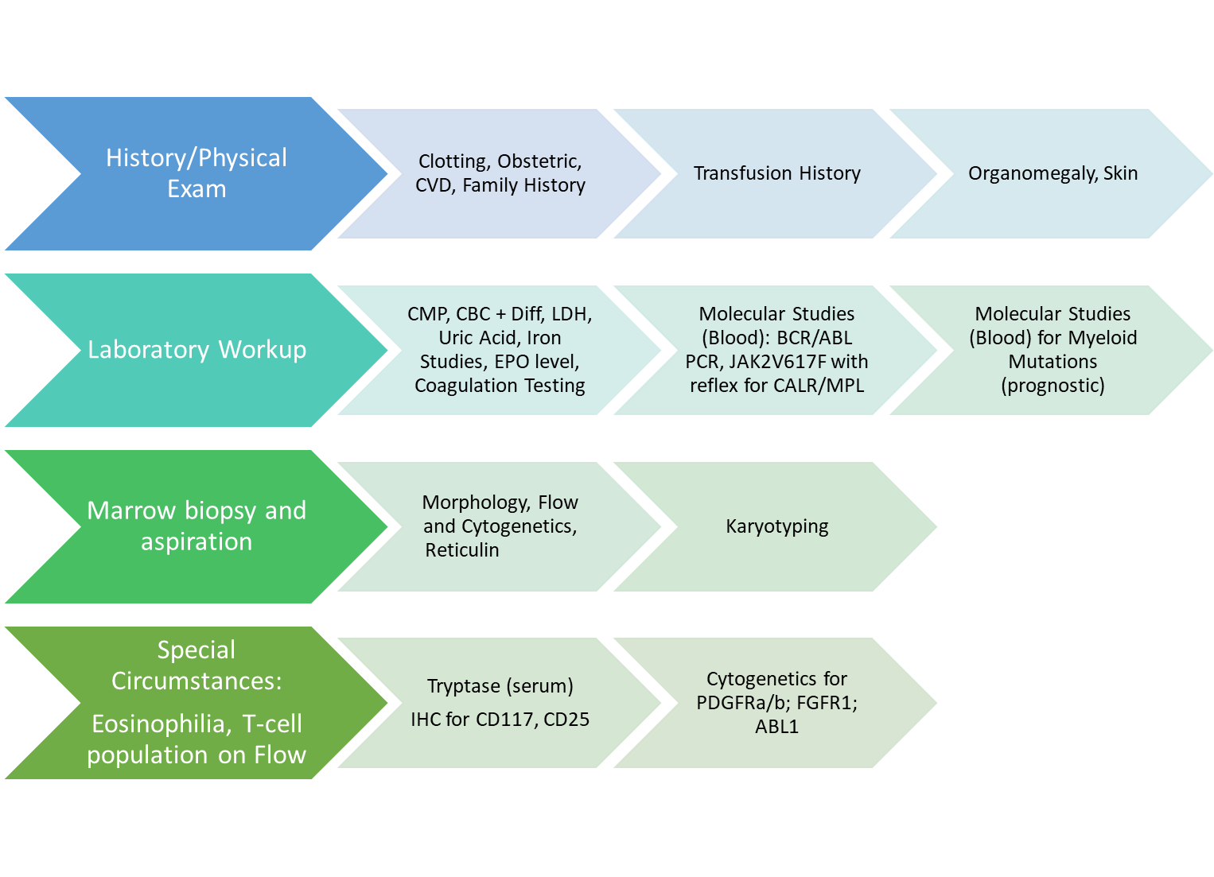
Initial Approach

Slide 5
Laboratory Findings
Laboratory Finding (following hospital presentation) | Result | Reference
White Blood Count | 8.3 x 10¹²/L | 4.5 - 11.0 x 10⁹/L
Hemoglobin | 13.2 gm/dL | 12.0 - 15.0 x 10g/L
Hematocrit | 44.4 % | 35% - 46%
Red Blood Cell Count | 7.32 | 3.8 - 5.0 x 10¹²/L
Mean Corpuscular Volume | 69.4 | 78.0 - 96.0 fL
Platelet Count | 865 | 150 - 450 x 10⁹/L
JAK2 V617F | positive | Negative
Erythropoeitin | <1.5 | 4.3 - 29.0 mUI/mL

Slide 6
What is the diagnosis?
What are the appropriate definitions to use?
Do we have sufficient information?

Slide 7
Essential Thrombocythemia: WHO 2016
Major criteria
Platelet count ≥450 x 10⁹/L (≥450,000/microL)
Bone Marrow Biopsy: proliferation mainly of the megakaryocyte lineage with increased numbers of enlarged, mature megakaryocytes with hyperlobulated nuclei. No significant increase or left shift in neutrophil granulopoiesis or erythropoiesis and very rarely minor (grade 1) increase in reticulin fibers
No criteria for BCR-ABL1-positive chronic myeloid leukemia, polycythemia vera, primary myelofibrosis, myelodysplastic syndrome, or other myeloid neoplasm
JAK2, CALR, or MPL mutation
Minor criterion
Another clonal marker or no identifiable cause of thrombocytosis (eg, infection, inflammation, iron deficiency anemia)
All four major or 3 major + minor

Slide 8
Polycythemia Vera: WHO 2016
Major criteria
Increased hemoglobin level (>16.5 g/dL in men or >16.0 g/dL in women), hematocrit (>49 percent in men or >48 percent in women), or other evidence of increased red cell volume
Bone marrow biopsy: hypercellularity for age with trilineage growth (panmyelosis) including prominent erythroid, granulocytic, and megakaryocytic proliferation with pleomorphic, mature megakaryocytes (differences in size)
JAK2 V617F or JAK2 exon 12 mutation
Minor criterion
EPO level below normal
Need all major or two major and the minor criteria

Slide 9
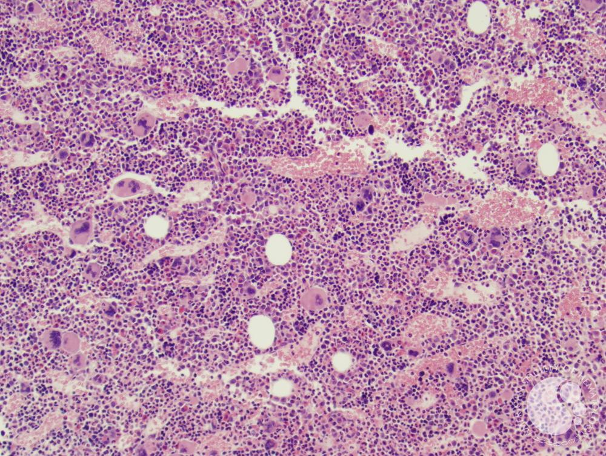
Hypercellular Marrow
Panmyelosis
Credit, ASH IMAGE BANK, Author: Elizabeth L. Courville, MD
Copyright © 2023 American Society of Hematology. Copyright restrictions may apply.
Notes:
The trephine core shows a hypercellular marrow for age with panmyelosis (proliferation of the erythroid, granulocytic, and megakaryocytic lineages).Megakaryocytes are increased and include frequent hyperlobated forms.

Slide 10
Increased, hyperlobated megakaryocytes
Credit, ASH IMAGE BANK, Author: Elizabeth L. Courville, MD
Copyright © 2023 American Society of Hematology. Copyright restrictions may apply.

Slide 11
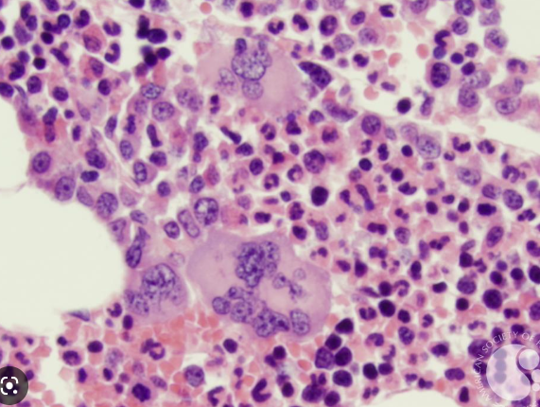

Slide 12
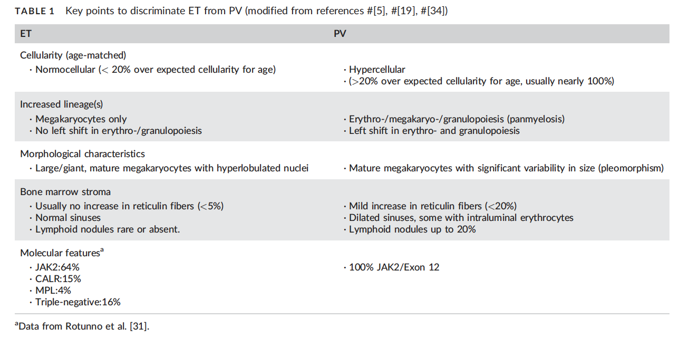
ET vs mPV: Key Differences
ELN study June 2017
Review of 98 marrow specimens by panel of hematopathologic experts
2016 WHO criteria validated that there are reproducible differences between mPV and ET

Slide 13
Does the distinctionmatter?
Therapeutic Implications
Different standards for treatment
CYTO-PV study demonstrated, in PV patients, necessity of phlebotomies to maintain HCT=<45%
Marchioli et al., NEJM 2013
Clinical trial enrollment
Prognostic Implications

Slide 14
Is this mPV? Or PV?
Prognostic Implications
mPV vs. Overt PV → significantly higher rates of progression to myelofibrosis and acute leukemia and inferior survival.
Barbui et al., AJH January 2014

Slide 15
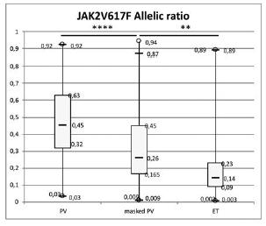
Allelic Burden may also Differentiate
Analysis from French researchers
Maslah et al, Haematologica 2020
Looked at >2400 patients who had undergone red cell mass testing (RCM), and then categorized them as PV, mPV, and ET
 | PV | mPV | ET (JAK2+)
Mean JAK2 V617F allele burden ratios | 46% (+/- 22%) | 31% (+/- 23%) | 19.9% (+/-20%)

Slide 16
Case #1
38-yo female
Diagnosis:
Masked Polycythemia Vera
Risk Assessment:
High Risk (History of Thrombosis)
Treatment/Intervention:
Discontinuation of oral contraception
Cardiovascular risk reduction
Cytoreduction
Phlebotomies
Pegylated Interferon or Hydroyurea
Aspirin therapy
Notes:
Near complete occlusion of the portal-mesenteric venous system (as detailed), likely acute on chronic given cavernous transformation at the porta hepatis. Of note, the very proximal (small) ileal and jejunal territories to the SMV are still patent. 2. Normal bowel wall enhancement. 3. Splenomegaly.
EPO level is in the low normal range: 5 (range is 4-10)

Slide 17
Clinically difficult questions….
Lifelong anticoagulation?
Can a Direct Oral Anticoagulant be Used?
Aspirin 81mg daily + anticoagulation?
Once daily or twice daily aspirin therapy?

Slide 18
Direct Oral Anticoagulants (DOACs) in MPNs
Convenient
Current randomized trial (AIRPORT MPN NCT NCT04243122) will randomize patients to apixaban vs aspirin
But what about secondary prophylaxis?
Recent systemic review (Baysal et al., Expert Rev Hematology, Feb 2023)
11 Studies, 944 patients – Not high quality data
Initiation of DOACS
Secondary prophylaxis for thrombosis (arterial or venous)
Atrial fibrillation (AF)
Recurrent throbotic event rate 8.9%
ISTH Analysis (Barbui et al., Res Prac Thromb Haemost 2022)

Slide 19
Masked PV: Take Home Points
Diagnostics matter
Morphologic changes can be the tie-breaker
Unanswered questions call for thoughtful shared decision making

