Slide 1
Should interferon be standard first line therapy for high-risk PV patients?
Heinz Gisslinger
Medical University of Vienna
Department of Internal Medicine I

Slide 2
Disclosures – Heinz Gisslinger
 | Consultant | Research Funds (Institution) | Speakers Honorarium
AOP Orphan | + | + | +
Novartis | + |  | +
Celgene/BMS | + |  | +
GSK | + |  | +

Slide 3
Patient-centered treatment goals in polycythemia vera (PV)
Ameliorate the symptom burden
To improve quality of life, therapy should address PV symptoms while reducing phlebotomies to avoid adverse effects associated with iron-deficiency¹
Minimize the risk of progression to acute leukemia or myelofibrosis
Slowing disease progression is patients’ highest priority²
Prevent thromboembolic complications
Associated with increased mortality risk according to real-world evidence³
¹ Heidel et al. Leukemia. 2018 Sep;32(9):2085-2087
² Mesa et al. Cancer. 2017 Feb 1;123(3):449-458.
³ Pemmaraju et al. Leuk Res. 2022 Apr;115:106809

Slide 4
Cytoreductive treatment options
What is available/standard in PV?
- Hydroxyurea (HU) – approved for PV
Interferon (IFN) – approved for PV
Ruxolitinib –approved for PV
Combinations IFN + RUX not approved
Older agents (pipobroman, busulfan etc.)
no longer recommended

Slide 5
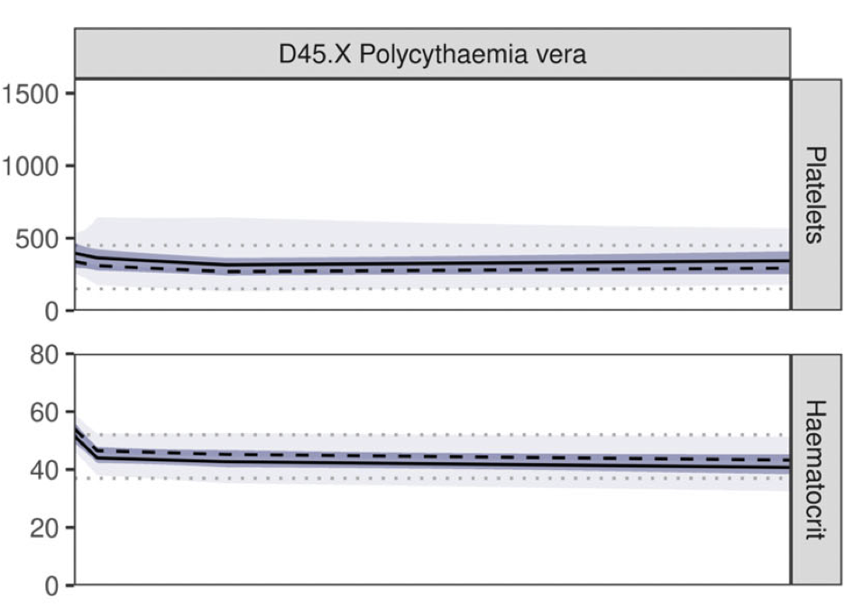
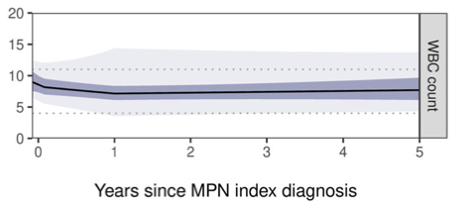
Retrospective analysis - treatment of PV: Longitudinal trends of peripheral blood counts in polycythaemia vera patients in the UK
Carpenter L et al., eJHaem., 2022

Slide 6
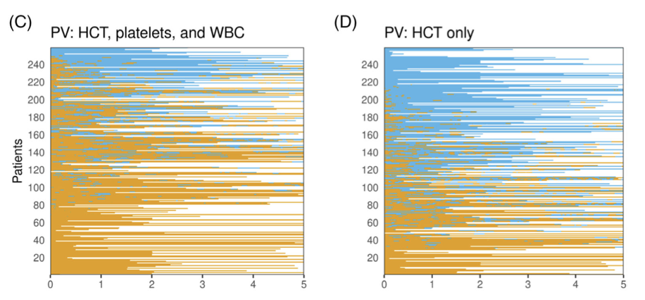
Retrospective analysis: Longitudinal trends of peripheral blood counts in polycythaemia vera patients in the UK
Follow-up in years
Carpenter L et al., eJHaem., 2022

Slide 7
Retrospective analysis: Longitudinal trends of peripheral blood counts in polycythaemia vera patients in the UK
Treatment target reached
CR HCT PLT WBC
PV n = 429 29,1% 29,1% 77,3%. 74,6%
Carpenter L et al., eJHaem, 2022

Slide 8
Patient-centered treatment goals in polycythemia vera (PV)
after 6 years of treatment
Gisslinger H, et al. EHA 2022

Slide 9
Final study results confirm higher response rates for ropeginterferon alfa-2b versus control treatment at 6 years
Results from CONTINUATION-PV at 6 years agreed with previously published interim analyses,^{1,2} demonstrating higher rates of complete hematologic response (CHR) and molecular response (MR [partial/complete] using ELN criteria) among ropeginterferon alfa-2b treated patients compared to the control group
 | Ropeginterferon alfa-2b N=95 |  | Control N=74 |  | RR (95% CI) | P-value
CHR* | 48/88 | 54.6% | 22/63 | 34.9% | 1.55 (1.07 to 2.26) | p=0.02
MR* | 62/94 | 66.0% | 14/72 | 19.4% | 3.23 (2.01 to 5.19) | p<0.0001
Full analysis set
¹ Gisslinger et al. Lancet Haematol. 2020 Mar;7(3):e196-e208
² Kiladjian et al. Leukemia. 2022 May;36(5):1408-1411.
*CHR based on blood counts; MR according to ELN criteria (Barosi et al Blood. 2009 May 14;113[20:4829-33] with last observation carried forward

Slide 10
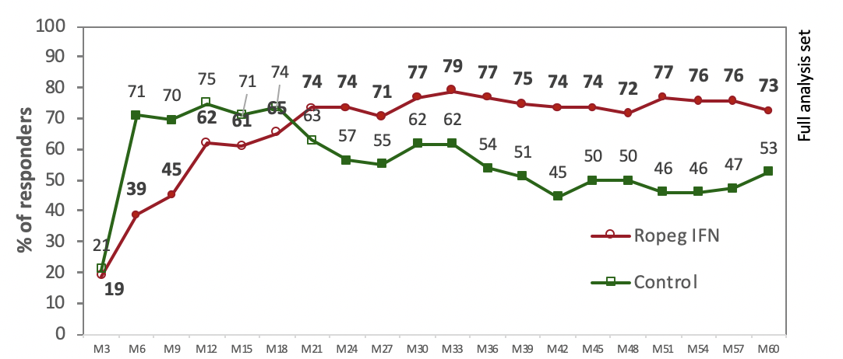
PROUD/CONTi-PV Study
Complete clinicohematologic response (CHR) at 60 months (treatment withdrawals appr. 23% in both arms Proud/Conti-PV Study)
Median JAK2V617F allele burden (LOCF)
Gisslinger et al, ASH 2020

Slide 11
Freedom from phlebotomy
p=0.01**
p= 0.007**
p=0.005**
Full Analysis Set
In the 6th year of treatment, no phlebotomies were required to maintain hematocrit <45% in 81.4% of patients receiving ropeginterferon alfa-2b compared with 60.0% of patients in the control arm (p=0.005).
*Among patients with available data for each treatment year **Likelihood of ratio test (incidence ratio for no phlebotomy vs at least 1 phlebotomy)

Slide 12
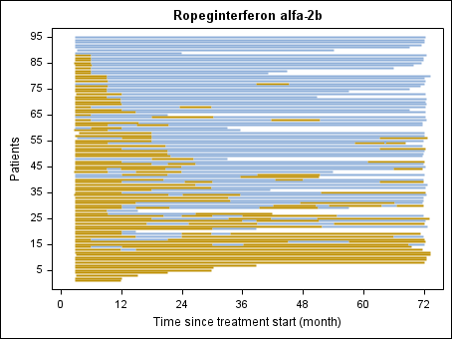
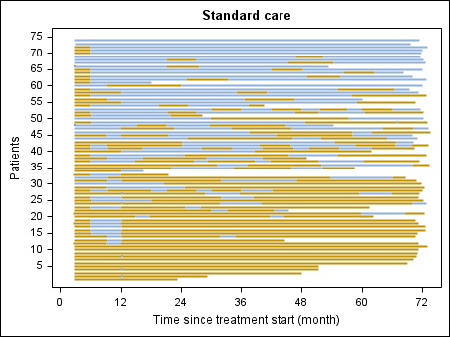
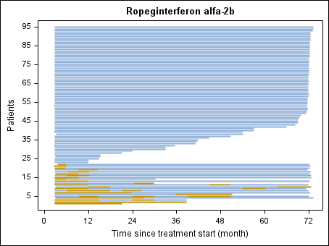
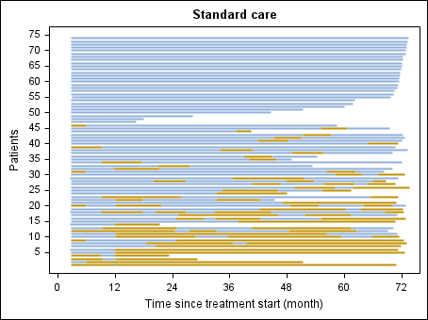
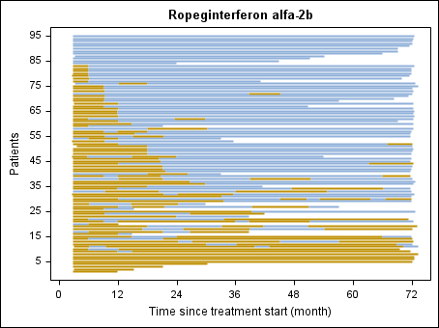
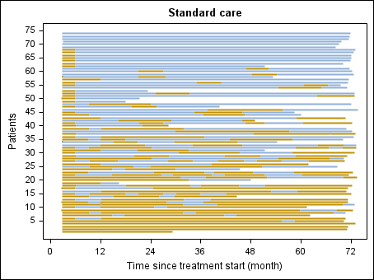
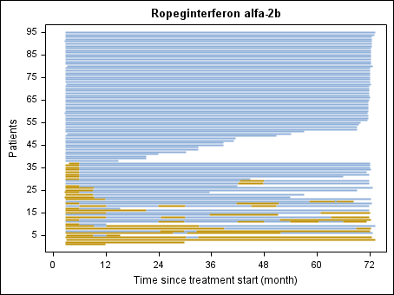
PROUD/CONTi-PV Study: Proportion of follow-up time¹ spent in peripheral blood count remission in two populations of patients with PV
A. Haematocrit,
Leukocytes
and Platelets
C. Leukocytes
D. Platelets
B. Haematocrit
Gisslinger et al, EHA 2022
Gisslinger H, et al. submitted

Slide 13
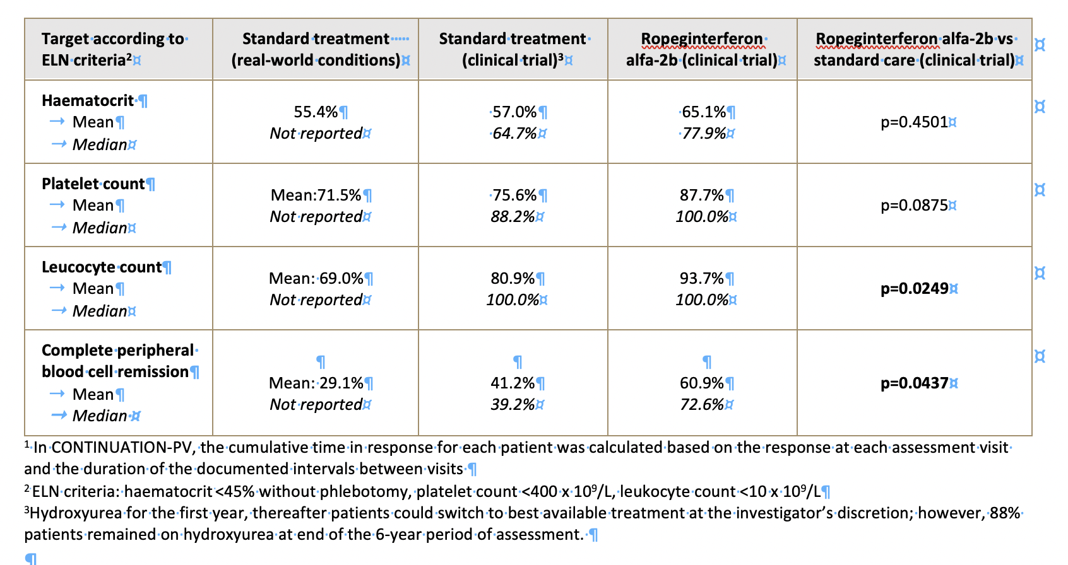
PROUD/CONTi-PV Study: Proportion of follow-up time spent in peripheral blood
count remission in two populations of patients with PV
Carpenter L et al., eJHaem., 2022
Gisslinger H, et al. submitted

Slide 14
Evaluation of PV-related symptom burden
The 10 most clinically relevant PV-related symptoms have been defined in an abbreviated version of the Myeloproliferative Neoplasm Symptom Assessment Form (“MPN-10”)¹:
MPN-specific questionnaires could not be applied in the PROUD-PV/CONTINUATION-PV trials (due to lack of validation in all languages at the time of trial start)
In a post-hoc analysis, the patient-reported PV symptom burden was assessed based on adverse events documented in the patient diary and recorded at each visit
The MPN-10 symptoms were evaluated in each treatment arm based on the adverse events and their respective medical synonyms
Fatigue | Early satiety | Concentration problems | Inactivity | Night sweats
Itching | Bone pain | Abdominal discomfort | Weight loss | Fevers
Gisslinger et al, EHA 2022
Gisslinger H, et al. submitted
¹ Emanuel et al. J Clin Oncol. 2012 Nov 20;30(33):4098-103
Notes:
Emanuel and colleagues showed that symptom burden as measured by the MPN-SAF TSS was strongly correlated with QoL (Pearson ∣r∣=.51; P <.001) as measured by the Global Health Status/QoL (GHS/QoL) scale of the European Organization for Research and Treatment of Cancer Quality of Life Questionnaire Core 30 (EORTC QLQ-C30) (Aaronson etal, J Natl Cancer Inst. 1993. March 3;85(5):365–76.)

Slide 15
Patient disposition and dosing
As of Year 6, 88% of patients in the control arm remained on hydroxyurea as best available treatment.
The remaining 12% of patients in the control arm had switched to an interferon therapy as best available treatment at Year 6. Patients were analyzed according to assigned treatment group.
The median cumulative 4-weekly dose of ropeginterferon alfa-2b was 499 µg (IQR: ±268-782 µg) in the 6th year of treatment; the median dose of hydroxyurea was 1000 mg/day (IQR: 750-1500 mg).
Gisslinger et al, EHA 2022
Gisslinger H, et al. submitted
Notes:
„Year 6“ refers to the Month 72 assessment visit

Slide 16
PV-related symptoms
In this early-stage PV population, patient-reported symptoms defined in the MPN-10 were present in a small minority (9.5%) of patients in each arm at baseline (up to Week 4 of treatment)
Occurrence of disease-related symptoms remained low over long-term treatment. Symptoms were reported in 15.7% of patients in the ropeginterferon alfa-2b arm and 20.7% in the control arm during the 6th year of treatment
Gisslinger et al, EHA 2022
Gisslinger H, et al. submitted
Notes:
These results are in line with the pooled analysis of the MRC trials recently published in Lancet Haematology – a significant decrease in symptom burden could only be shown among patients with a high burden at baseline

Slide 17
Change in occurrence of symptoms during ropeginterferon Year 1 versus Year 6
Occurrence of symptoms defined in the MPN-SAF-TSS ("MPN-10") was lower in the 6th year of treatment with ropeginterferon alfa-2b than during the 1st year (from Week 4) for 6 of the 10 symptoms
Gisslinger et al, EHA 2022
Gisslinger H, et al. submitted
Notes:
These results are in line with the pooled analysis of the MRC trials recently published in Lancet Haematology – a significant decrease in symptom burden could only be shown among patients with a high burden at baseline

Slide 18
Potential disease modification
Depletion of the JAK2V617F allele burden may lower the risk of progression of PV to secondary myelofibrosis.^{1,2}
After 6 years of treatment, the JAK2V617F allele burden decreased to <1% in 20.7% of patients in the ropeginterferon alfa-2b arm.
In contrast, only 1.4% of patients in the control arm achieved an allele burden <1% at 6 years of treatment (p=0.0001).
p=0.0001
Full Analysis Set
*Analyzed in patients with baseline allele burden >10%; last observation carried forward
¹ Alvarez-Larrán et al., 2014 Am J Hematol. 2014 May;89(5):517-23
² Passamonti et al., 2010. Leukemia. 2010 Sep;24(9):1574-9
Gisslinger et al, EHA 2022
Gisslinger H, et al. submitted
Notes:
At 6 years=analyzed at Month 72 assessment visit

Slide 19
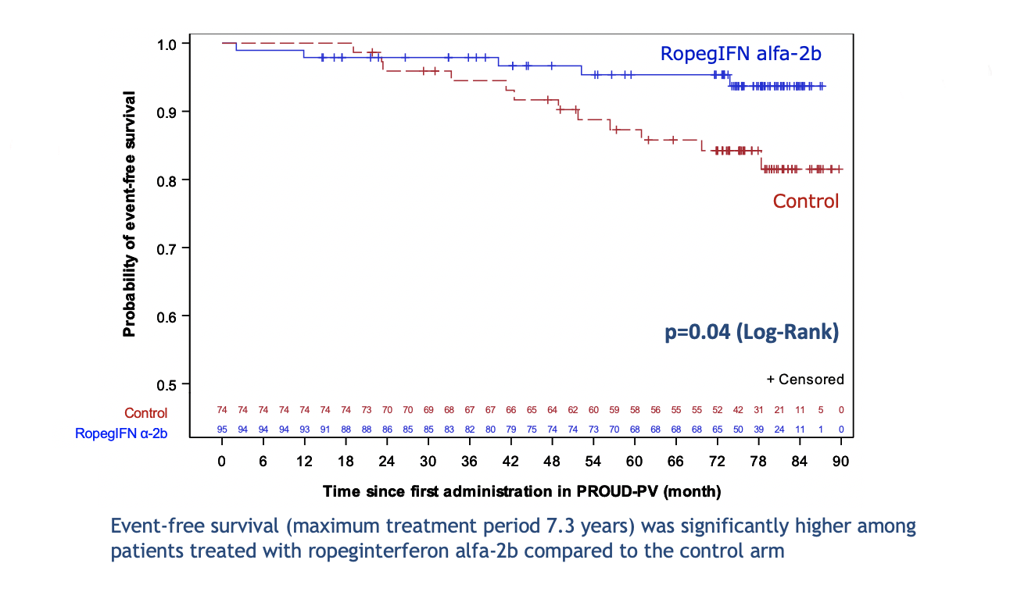
Event-free survival Risk events: death, disease progression and thromboembolic events
Gisslinger et al, EHA 2022
Gisslinger H, et al. submitted

Slide 20
Ropeginterferon: Conclusion
Long-term ropeginterferon alfa-2b therapy fulfils treatment goals important to patients with PV:
Good quality of life as indicated by a low symptom burden and low phlebotomy requirement
Potential to influence disease progression
Higher probability of event-free survival compared with best available treatment

Slide 21
CEMPO Treatment Guidelines for PV
Patients
Low-Risik PV
High-Risiko PV
Age <70 w/o severe Comorbidities
Age ≥70 with or w/o Comorbidities
1st Line Therapy
Low-Dose Aspirin
+ Phlebotomy
Interferon-α
Interferon-α
or Hydroxyurea
2nd Line Therapy
Interferon-α
Hydroxyurea/
JAK2-Inhibitor
JAK2-Inhibitor
Hatalova et al, Eur J Haematol. 2018

