Slide 1
Essential Thrombocythemia: Standard and Novel Treatments
Brady L. Stein, MD MHS
Professor of Medicine
Division of Hematology/Oncology
Northwestern University Feinberg School of Medicine

Slide 2
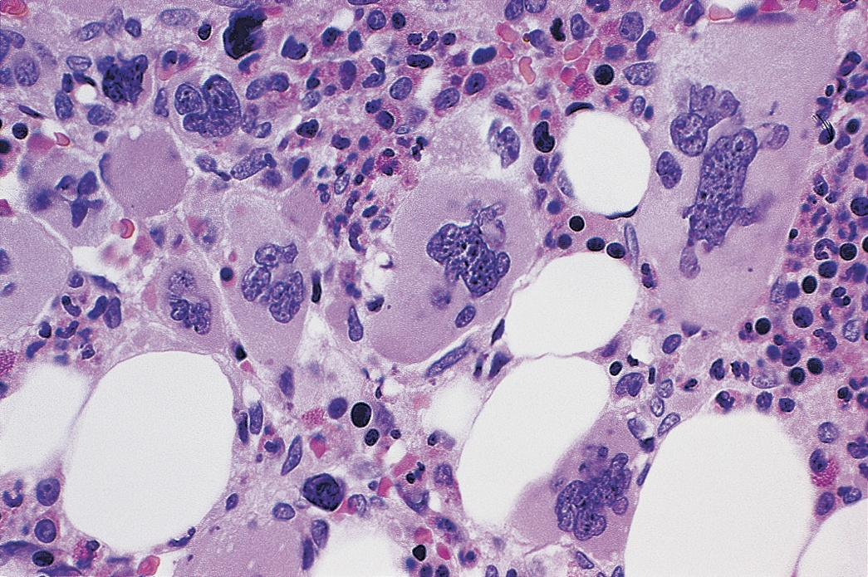
Essential Thrombocythemia
Major criteria:
1. Platelets > 450 x 10⁹/L
2. BM bx showing proliferation mainly of the megakaryocyte lineage with
↑ numbers of enlarged, mature megakaryocytes
3. Not meeting WHO criteria for CML, PV, MF, MDS, or other myeloid neoplasms
4. Presence of JAK2, CALR or MPL mutation
Minor criterion:
Presence of a clonal marker or absence of evidence for reactive thrombocytosis
Diagnosis of ET requires meeting all 4 major criteria or the first 3 major criteria and the minor criterion
Arber DA, et al. Blood. 2016;127:2391-2405

Slide 3
ET: Importance of a proper diagnosis
 | “True ET” | Prefibrotic MF
Clinical features | Sustained thrombocytosis | Sustained thrombocytosis Anemia Leukocytosis >11 x 10⁹/L Palpable splenomegaly ↑LDH
Bone marrow | ↑ Enlarged, mature MK’s w/ hyperlobulated nuclei | Atypical MK proliferation, w/o reticulin fibrosis > grade 1, w ↑ BM cellularity, granulocytic proliferation and often ↓ erythropoiesis
Mutations | JAK2, CALR, MPL (~90%) | JAK2, CALR, MPL (~90%)
Overt MF at 15 yrs | 9% | 17%
Cumulative AML at 15 yrs | 2.1% | 11.7 %
15 yr survival | 80% | 59%
Important to r/o CML, PV, ET, MDS and reactive causes of thrombocytosis or fibrosis

Slide 4
Mutational Profile: ET
Thrombosis Risk
ET
CALR-ET
10 yr CI: 5%
Triple-negative ET
10 yr CI: 8%
JAK2 V617F + ET
10 yr CI: 14.5%
MPL-ET
10 yr CI: 19.5%
IPSET-thrombosis, revised
Very Low Risk:
Age ≤ 60, no thrombosis
JAK2 negative
Low Risk:
Age ≤ 60, no thrombosis
JAK2 positive
Intermediate
Age > 60
No thrombosis, JAK2 negative
High risk
Thrombosis hx, or Age > 60 and JAK2 mutated
CI=cumulative incidence

Slide 5
The ET disease Burden
Symptoms (Independent from risk)
Cytokine: Fatigue, Pruritus, Constitutional Sx, Bone pain
Vascular: HA, dizziness, numbness, ↓concentration
Low mood, sexuality problems
Disease evolution: Splenomegaly, Constitutional Sx
Thrombosis
Micro/Macrovascular
Arterial > Venous
Unusual sites: Age/Gender
Disease transformation
Myelofibrosis
AML
Newly diagnosed
Typically second decade
Important to follow symptom burden as even low risk pts can have a pronounced burden!
Mesa RA, et al. Cancer. 2007;109(1):68-76; Scherber et al Blood 2011; Geyer et al Blood 2014;
Notes:
From an internet based survey of 1179 MPN patients (456 with MF)
Fatigue (84%)
NS (56%)
Pruritus (50%)
Bone pain (47%)
Weight loss and fever (18, 20%)

Slide 6
Management: Antiplatelet therapy for primary prophylaxis
ET
PV
MF
Net effect positive
Low dose aspirin unless contraindicated
ECLAP: ~60% risk reduction in nonfatal MI/CVA, major VTE, CV death
Net effect uncertain
Certainty of evidence “low” or “very low” for RR’s of thrombosis and bleeding (24 studies,6153 pts)
↑ Bleeding in CALR-ET pts treated w/ antiplatelets vs. observation (12.9 vs. 1.8 episodes p=.03)
Net effect uncertain
Absent data, but ASA for pre-MF pts w/:
Microvascular sx
Prior arterial thrombosis
Advanced age
CV risk factors
JAK2 V617F
Leukocytosis
I use for JAK2 positive ET (low risk and beyond); 2◦ prophylaxis if prior arterial thrombosis or microvascular sx
Chu Ann. Intern Med 2017; Alvarez-Larran Haematologica 2016; Finazzi BCJ 2018 (pre-MF treatment algorithm)

Slide 7
Management: Antiplatelet therapy for primary prophylaxis
I am not yet recommending BID aspirin, but this is under evaluation in ET
Rocca B, et al. Blood. 2020;136:171-182.

Slide 8
Cytoreduction: HU in high-risk ET pts
HU Studies | Number/MPN type | Intervention | Comparator | Thrombosis Outcomes
Cortelazzo NEJM 1995 | 114 high-risk ET | HU Randomized | No cytoreduction | Favors HU (3.6% vs. 24%)
Harrison NEJM 2005 | 809 high-risk ET | HU/ASA Randomized | ANA/ASA | Favors HU (arterial thrombosis)
Godfrey JCO 2018 | 382 non-high risk ET | HU/ASA Randomized | ASA | Against HU -No difference in thrombosis or vascular death rate
Notes:
* On study events; all events, first 378 weeks—13.7% vs 38.1%

Slide 9
Other Cytoreductive Agents Front-Line Peg-IFN
Control counts, ↓thrombosis risk; induce anti-clonal activity: delay evolution?
MPD-RC 112: Peg-IFN vs HU (ET)
N = 81 ET (168 overall), newly diagnosed, high risk, treatment-naive
ORR (CR): HU vs peg-IFN 12m: 71% (45%) vs. 69% (44%) 24m: 33% (25%) vs. 58% (38%) 36m: 33% (17%) vs. 60% (40%)
Histological responses more frequent with HU (CR---8/23 ET vs. 2/23 PEG) VAF: -5% and -10%, overall, HU and peg-IFN
Grade 3/4 AEs, HU vs peg-IFN: 28% vs. 46% (ET and PV)
Conclusion: Similar CR rates at 12 months Each potentially capable of addressing natural history (No difference in limiting thrombotic events or disease progression)
95% CI crossed 1 for each comparison
Mascarenhas et al, Blood 2022
Notes:
AE = adverse event
ASH = American Society of Hematology
CHR = complete hematologic response
CMR = cardiac magnetic resonance
CR = complete response
DC = discontinuation
GI = gastrointestinal
IFN = interferon
MSK = Memorial Sloan Kettering
ORR = overall response rate
Peg = pegylated
PR = partial response
Clinical, hematological, morphological, and molecular responses
Turlure:
13/20 dc’s received no further therapy, and 10/13 still in hematological CR off therapy after 28 months -- 29% could stop w/o requiring further therapy

Slide 10
Second-line Peg-IFN
MPD-RC 111: Salvage Peg-IFN (N = 65 ET)
Patients who are HU resistant or intolerant
CR/PR at 12 months: 43% and 26% (ORR 69%) CR rates higher in CALR positive patients 45 of 65 (69%) achieved platelets < 400k at 12 months
CI vascular events at 2 years: 5%
12% of ET patients with histological remission Median VAF reduction 6% in patients w/ CR
Discontinuation due to AEs: 14% (ET and PV included) 90% with AE’s; 44% with ≥ Grade 3 AE’s
Ropeginterferon is also under evaluation in ET 2nd line, high-risk ET
Compared to Anagrelide
Surpass-ET study
Yacoub A, et al. Blood. 2019;134:1498-1509.
Notes:
MDACC = MD Anderson Cancer Center
HR = hazard ratio
AEs = adverse events
CMR = complete molecular response
MR= molecular response
ORR = overall response rate
CI = cumulative incidence
VAF = variant allele frequency
HU = hydroxyurea
HCT = hematocrit
CR = complete response
PR = partial response

Slide 11
MAJIC-ET: Rux vs BAT in HU R/I patients: Efficacy
 | Rux (N=58) | BAT (N=52) BAT used at least once: HU (71%), ANA (48%), IFN (40.4%) | Significance?
CR, n (%) | 27 (46.5%) | 23 (44.2%) | 0.4
OS, PFS | 98%, 93% | 98%, 96% | NS
Thrombosis | 10 pts (17%) | 3 pts (5.8%) | 0.09
Hemorrhage | 1.7% | 8.9% | P=0.14
MF transformation | 8 pts | 5 pts | NS
Composite outcome (thrombosis, hemorrhage, transformation |  |  | P=0.35
Molecular responses | 1 CMR, 1 PR (JAK2 positive) 2 CMR, 1 PMR (CALR positive) | 0
TSS reduction | Better max % TSS reduction and longitudinal sx control (pruritus 0.01) |  | Overall 50% TSS reduction similar between both arms
1 Rux pt transformed to AML
Harrison, et al Blood 2017

Slide 12
MAJIC-ET: Safety and Conclusion
 | Ruxolitinib | BAT
Anemia (G3/4) | 12/58 (21%) | 0
Thrombocytopenia (G3/4) | 2/58 (3.4%) | 0
Infections | G3 9/58 (15.5%) | G3 or 4 2/57 (3.5%); p=0.03
Deaths (none treatment related) | 5 | 2
Discontinuations | 9 transformation 11 loss of response 5 lack of efficacy 2 anemia | 3 transformation 0 loss of response 1 lack of efficacy 0 anemia But 30 switched their initial BAT choice
Superior symptom control, but no difference in control of blood counts, or rates of thrombosis, hemorrhage, or transformation
Harrison, et al Blood 2017

Slide 13
Novel agent: Pelabresib (BET inhibitor) in ET
N=20, CHR endpoint of interest
18/20 with hematological response; CHR in 40%
Symptom improvement in 86%
Most common AE’s:
60% nausea (10% grade 3)
Diarrhea 35% (5% grade 3)
Dysgeusia 35% (no grade 3)
No thrombocytopenia events
Passamonti et al, Abstract 7019 ASCO 2023

Slide 14
Novel agent: LSD1 inhibition in ET
LSD1 plays a role in self-renewal of malignant cells and progenitor differentiation
Bomedemstat is an oral LSD1 inhibitor that has reduced counts, spleen size, mutant allele burdens in mice
Global phase 2b study in 73 ET patients with intolerance or resistance to standard care
Key endpoints included safety and efficacy
(Plts < 400 x 10⁹/L without thrombosis)
Gill, et al ASH 2022

Slide 15
Novel agent: LSD1 inhibition in ET
Patient population
Median age 66
51% JAK2 positive, 36% CALR positive, 4% MPL
Other mutations in 32% (EZH2, ASXL1, U2AF1, RUNX1, IDH, NPM1, TP53)
90% with HU resistance or intolerance
Mean platelet counts 809 x 10⁹/L
Median time on treatment: 23 weeks
34/36 achieved platelets ≤ 400k in a median of 8 weeks (for pts treated more than 24 weeks)
Stable hemoglobin noted, of 7 with leukocytosis, all improved leukocytosis
79% (11/14) improved symptoms
67% had decrease in VAF
Dysgeusia (43%), fatigue (23%), TCP (23%; 6% g3/4), arthralgia (21%; g3/4: 3%)
15 dc’d treatment 9 due to AEs
Phase 3 study planned
Gill, et al ASH 2022

Slide 16
ET management
Manage Sx
Reduce risk for thrombosis/hemorrhage
Prevent/delay transformation
Manage Special Situations
Goals of Therapy
For all
Manage CV Risk Factors
R/o acquired VWD in those with plts > 1000 x 10⁹/L or bruising
*ASA did not impact thrombosis rate in CALR-ET, but ↑bleeding risk
In those w/ microvascular disturbance, CV risk, JAK2+
ASA?
Cytoreduction?
Indicated for High Risk
Not necessarily in very low/low/int risk
HU/IFN in high risk (>60 with JAK2+, or thrombosis history)
Unless thrombosis, VWD, refractory vasomotor sx, symptomatic thrombocytosis
2nd line options:
-IFN/HU (if not used) -*Anagrelide
-Clinical trial
No data to support ruxolitinib as of yet

